Slide 1
Breathable Space “A Holy Space”
In this video, Audrey Harrison, Conservation Technician, University of Arizona, Tucson; Darsita North, Research Specialist, ASU - School of Human Evolution and Social Change; and Natalia Miles, Andrew W. Mellon Fellow 2017-2018 Heard Museum, Gila River Indian Community, provide information on how to care for culturally sensitive and irreplaceable paper-based pieces, such as maps and legal documents, using environmentally-safe methods. “Breathable meaning using only organic materials to house or care for paper documents,” however more than that – “a holy space.”
This session was part of the ATALM annual conference held in Prior Lake, Minnesota, on October 8-11, 2018. https://www.sustainableheritagenetwork.org/digital-heritage/caring-culturally-sensitive-paper-documents

Slide 2
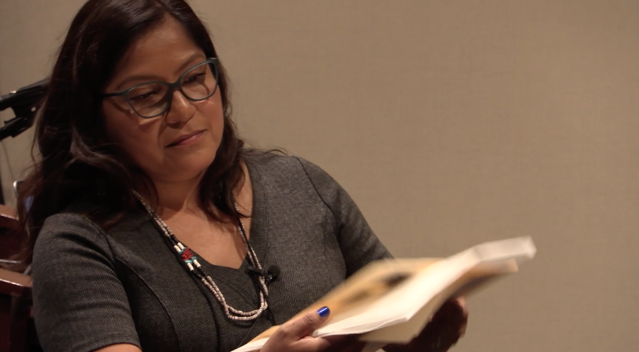
Preservation – Repair, treatment
Conservation – Prevention, maintenance
Stabilization – Provide support
“Preserve”
“Conserve”
“Sustain”
* Breathable – No chemicals, organic material
* Return to earth rather than stop or slow down natural process
*Each document is unique
*Care of documents the decision of the Tribal Community
Darisa North, ASU - School of Human Evolution and Social Change
https://www.sustainableheritagenetwork.org/digital-heritage/caring-culturally-sensitive-paper-documents

Slide 3
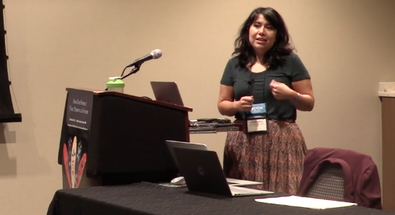
Powerful Documents
Natalia Miles, Andrew W. Mellon Fellow 2017-2018 Heard Museum, Gila River Indian Community
Discretefulness - Respect
Secure paperwork at end of day
Culturally sensitive documents – how treated? Conservation?
Cultural sensitive = transcripts of oral history, archaeological photographs, maps, treaties, up to tribal communities to decide
Object-centered approach to documents – tension
Not trying to prolonge – give it respect it needs

Slide 4
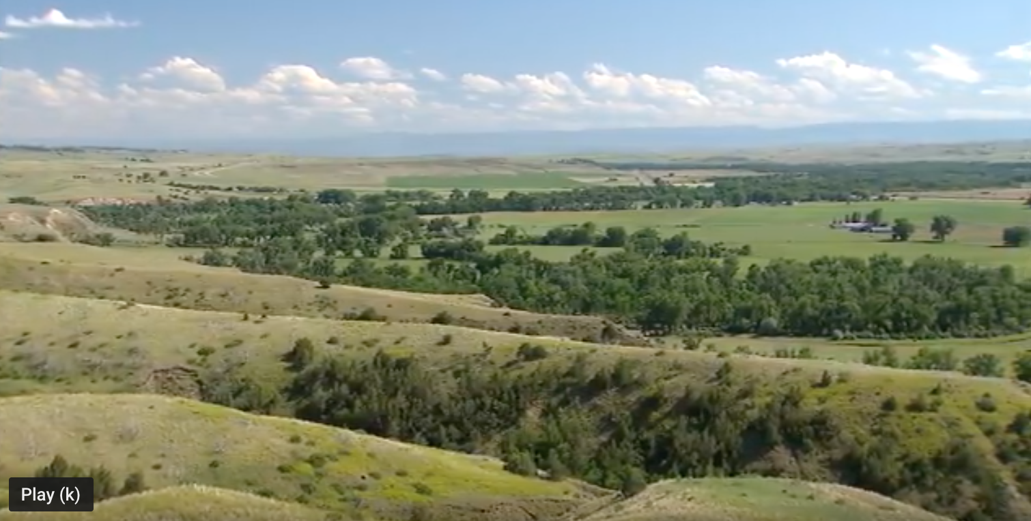
“Something Deeper Than Conservation Was Happening”
Audrey Harrison, Conservation Technician, University of Arizona, Tucson
1) Accommodations
2) People who are non-Native are hearing us
3) Cultural background comes out in the kind of work that we do
In 2011 the museum collections and archives which were stored in the basement of the existing visitor center were temporarily moved to the Western Archeological Conservation Center in Tucson Arizona.
Little Big Horn Battlefield National Monument
(Sioux, Cheyenne Crow, US forces – Montana)

