Slide 1
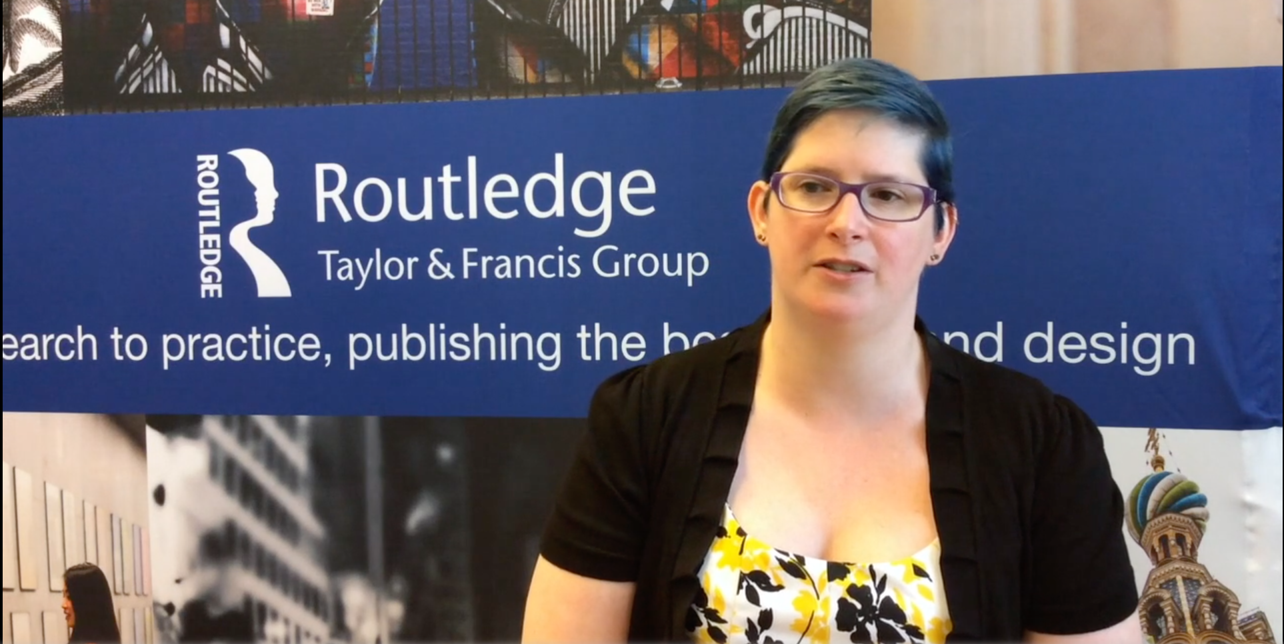
Beetham, Sarah. 2016. “From Spray Cans to Minivans: Contesting the Legacy
of Confederate Soldier Monuments in the Era of Black Lives Matter. Public Art Dialogue, 6:1, 9-33. https://doi.org/10.1080/21502552.2016.1149386
https://vimeo.com/185482688
Confederate soldier monuments have long been associated with political and racial power structures that perpetuate violence against black bodies, and the recent graffiti and calls for removal make this association clear. The vandalism directed at Confederate symbols should be understood as serious political speech directed at objects with a strong link to America’s racial history, and communities should address these concerns.

Slide 2
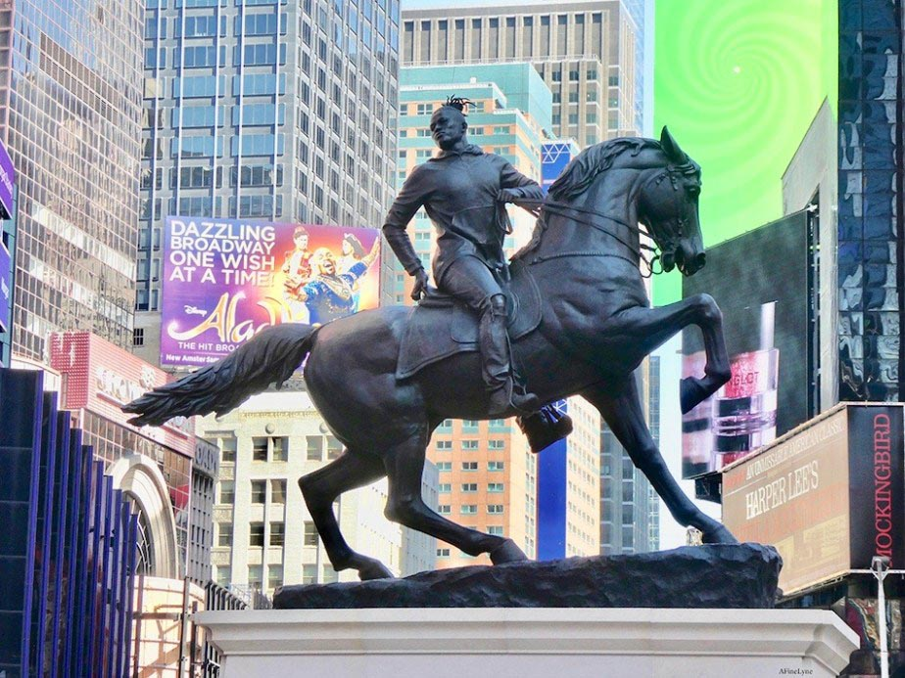
Ugwu, Reggie. 2019. “Kehinde Wiley’s Times Square Monument: That’s No Robert E. Lee.” September 27.
“Rumors of War,” Mr. Wiley’s largest sculpture to date at a towering 27 feet high and 16 feet wide, was inspired by the heroic, equestrian statues of Confederate generals in Richmond, Va., that line its famous Monument Avenue. After the sculpture leaves Times Square in December, it will be permanently installed in Richmond on Arthur Ashe Boulevard, a major thoroughfare, recently renamedafter the Richmond-born African-American tennis icon, that crosses Monument Avenue. “I’m a black man walking those streets,” he said at the unveiling on Friday, recalling his visit to Richmond. “I’m looking up at those things that give me a sense of dread and fear.” In 2017, after white nationalists in Charlottesville, Va. — protesting the planned removal of a Robert E. Lee statue there — ignited a deadly melee that sent shock waves throughout the country, Mr. Wiley redoubled his commitment to what became “Rumors of War.” https://www.nytimes.com/2019/09/27/arts/design/kehinde-wiley-times-square-statue.html

Slide 3
Rutherford Falls - https://www.youtube.com/watch?v=zX3ph5T-yek

Slide 4
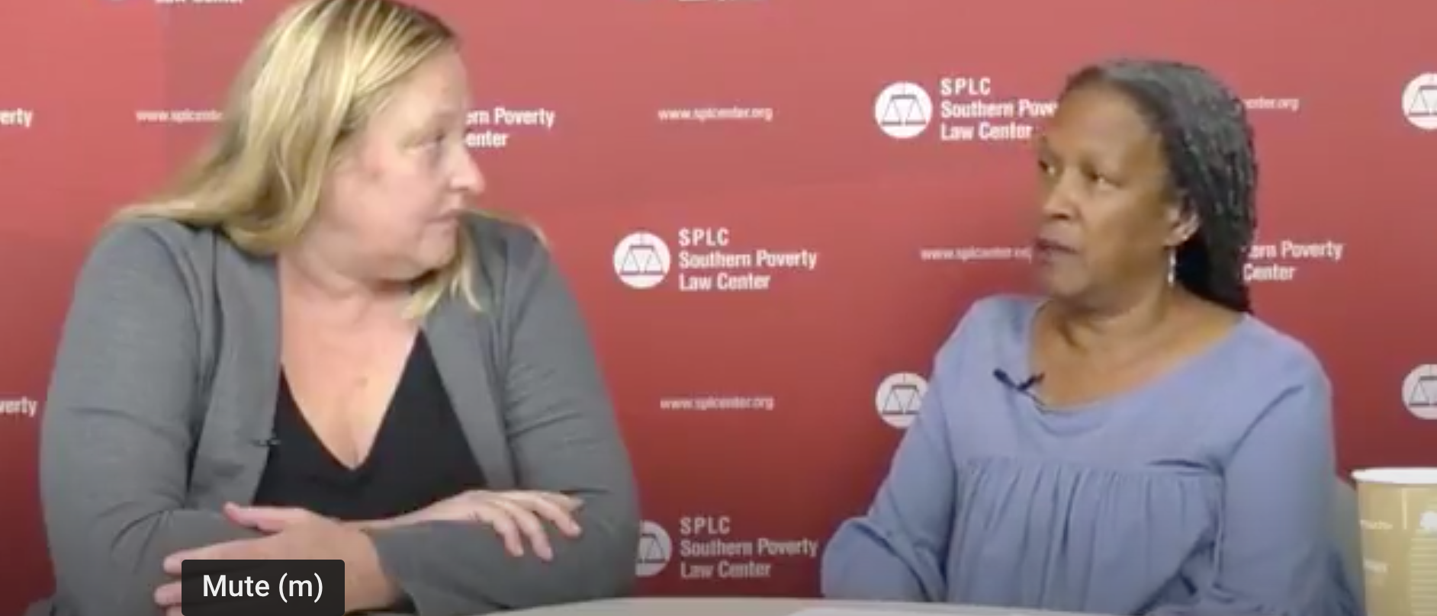
Whose Heritage? SPLC's Heidi Beirich and Lecia Brooks discuss Confederate symbols
https://www.youtube.com/watch?v=VWNE8GquGlc&t=6s @ 6:30 – 13:15.

Slide 5
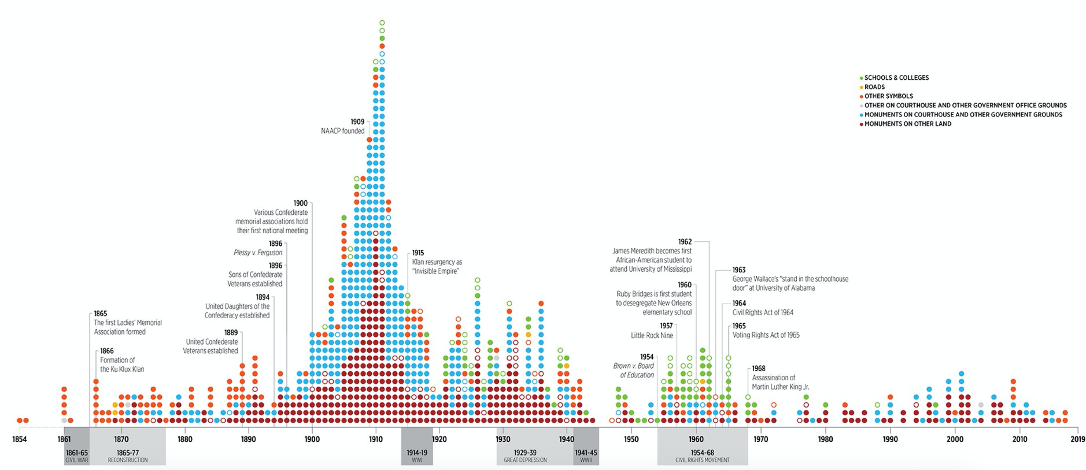
https://www.splcenter.org/20190201/whose-heritage-public-symbols-confederacy

Slide 6
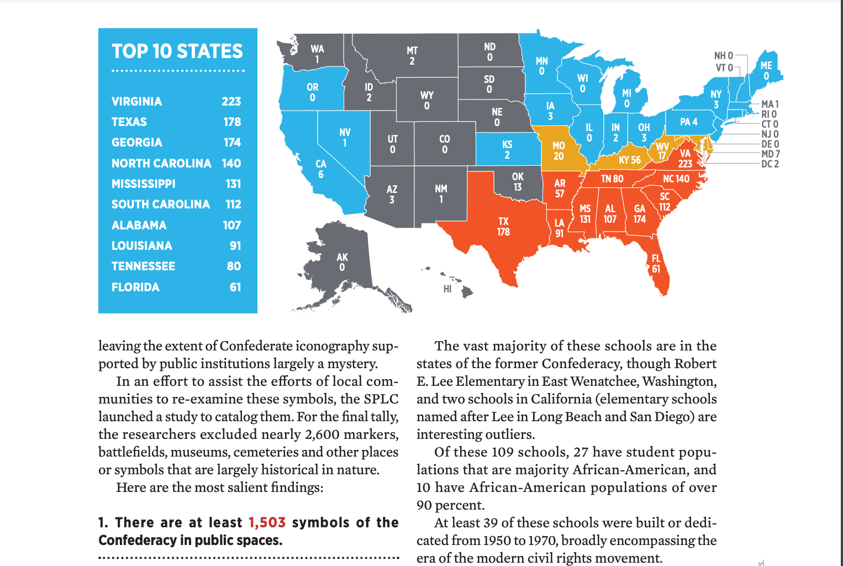
https://www.splcenter.org/sites/default/files/com_whose_heritage.pdf
https://www.google.com/maps/d/u/0/viewer?mid=1yDVZz93PUT3wDXpl4I-qmEQiSWqNtpzA&ll=38.19943672148611%2C-96.88488949999999&z=4

Slide 7
“Racist Monuments are Killing Us.”
Corporeality (something that has a physical form)
As a black woman, every time I pass a Confederate monument I am offended.. I am insulted by the fact that the city and country that I love continue to honor a violent
faction of the country that devalued my life. More important than how monuments provoke me affectively, the perpetual assaults are unequivocally deteriorating my health and shortening my life span.
Black Americans experience premature aging, chronic stress, and faster health deterioration than whites. This deterioration spans an individual’s lifetime but also across generations.
Chelsey Carter
Graduate Student Washington University in St. Louis,
black feminist activist-scholar focused on
medicine and health disparities

Slide 8
white-centered narrative
decenter whiteness
decolonizing methodologies
Create room to listen to the expertise of local community leaders who have been dealing with these debates and organizing these removals long before they were televised
Center actual community healing and tangible,
recognized reparations.
domestic terrorism
“…these monuments were constructed
by white supremacists in a desperate, rage-fueled
response to post–Civil War Black liberation.”
Duhé, Bailey. 2018.
Bailey Duhé PhD Candidate, UC Boulder “Decentering Whiteness and Refocusing on the Local: Reframing Debates on Confederate Monument Removal in New Orleans”

Slide 9
“On Monuments and Racial Violence.”
Strategies:
1) Dialogue
Build a new statue
Install provocative signage
2) Remove We already know about these histories
Decline in public health and well-being for people of color
Difference between the past and heritage
3) Place monuments in museums
No free space
Jeopardize relationships with local communities RE: These pieces were essentially mass-produced propaganda of the early twentieth century
These monuments normalize racism, first by ignoring the Indigenous lands upon which the United States exists and second, by choosing to minimize the impact of a unique manifestation of industrial capitalism that enslaved and brutalized hundreds of thousands of people forced to come to this country.
Diana Marsh is a postdoctoral fellow at the National Anthropological Archives, NMNH Smithsonian
Gwendolyn Saul New York State Museum.

Slide 10
Confederate Monuments – Put them in a Museum?
“The very act of containment tends to intensify the numinous potency of that which is contained, in time rendering it to new forms of veneration.”
“Museums remain vital liminal spaces, largely outside the tumult and balkanized acrimony of what passes for the public square in the age of cable news and Facebook feeds.
“We can and must serve as welcoming crossroads, especially at this global moment of imperiled democracy.”
“We must enact, through our moving bodies, the possibility of emerging from our long, common nightmare into an alternate, rejuvenated space of compassion and equal justice.”
Mark Auslander
Director, Michigan State University Museum Associate Professor, Department of History and Department of Anthropology
Liminal = A sensory threshold, a transitional space

Slide 11
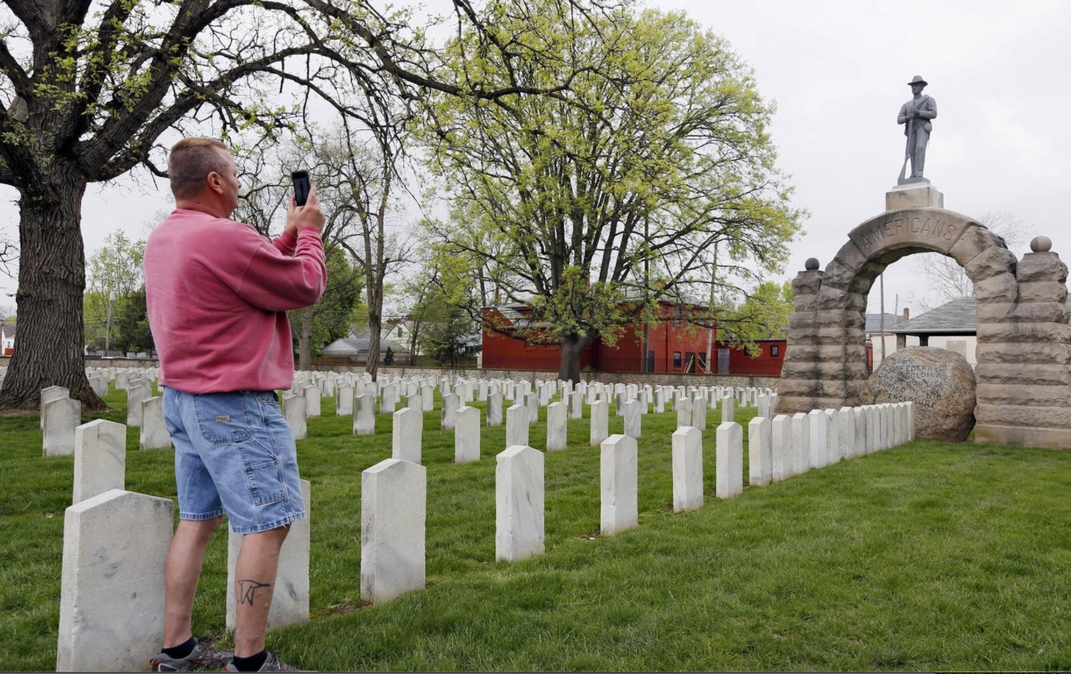
Are monuments only racist when they are in a public square? Does the meaning change in a cemetery?
Bosman - “Battle Over Confederate Monuments Moves to the Cemeteries”
In debates over Confederate sites like Beauvoir, and statues like Robert E. Lee in Charlottesville, you'll hear people defend them by saying, "They're part of our heritage, part of our history." But, how is that history being told, and more importantly, who's paying to keep it alive?
https://www.revealnews.org/episodes/monumental-lies/﻿
The Camp Chase statue was damaged less than two weeks after a woman was killed and dozens were injured by a Toledo-area man during a white-supremacist demonstration in Charlottesville, Virginia.https://www.dispatch.com/news/20190501/repaired-statue-of-confederate-soldier-reinstalled-at-camp-chase-cemetery

