Slide 1
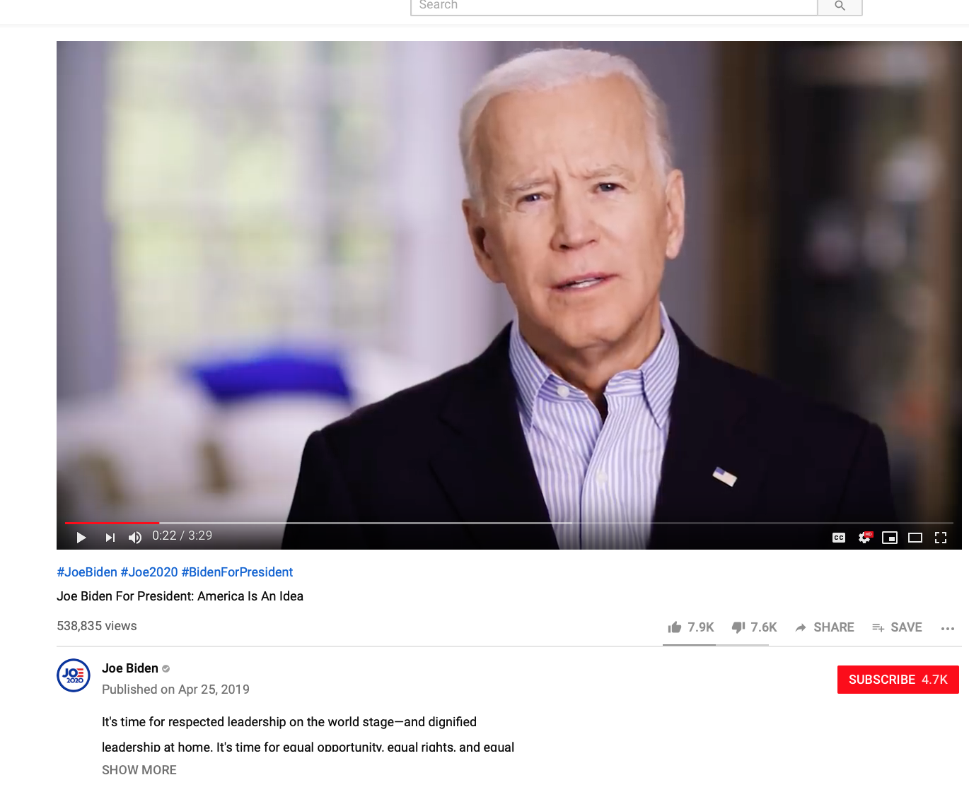
ALEXANDER BURNS, NATIONAL POLITICAL CORRESPONDENT:
This is some of the starkest language we have heard from any Democratic candidate regarding Mr. Trump and the hard-right nationalists who make up part of his base — references to Nazis and the Klan, and to forces that were on the march in 1930s Europe. Mr. Biden is using his age to his advantage here, presenting himself as a voice of historical authority, and situating the 2020 race in a much longer timeline.
https://www.nytimes.com/2019/04/25/us/politics/biden-campaign-video-announcement.html
https://www.youtube.com/watch?time_continue=9&v=VbOU2fTg6cI
April 25, 2019 Biden Announces Candidacy for Presidential Election
“We are in the battle for the soul of this nation.”

Slide 2
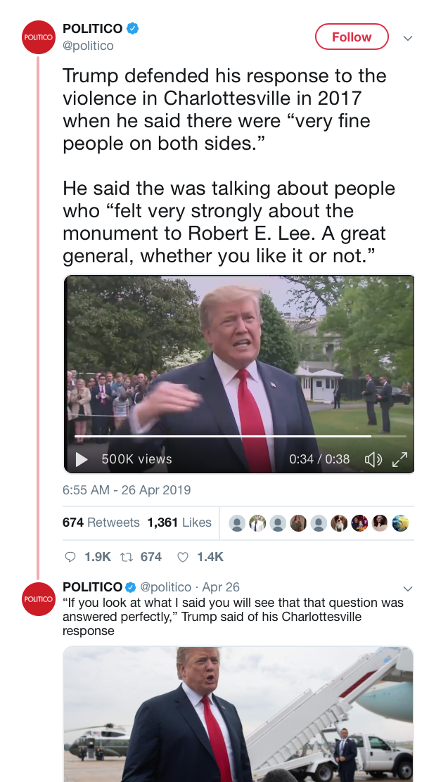
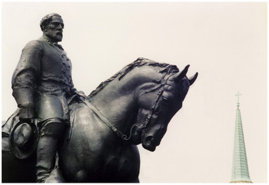
April 26, 2019
Trump defended his response to the violence in Charlottesville in 2017 when he said there were “very fine people on both sides.” He said the was talking about people who “felt very strongly about the monument to Robert E. Lee. A great general, whether you like it or not.”
https://www.encyclopediavirginia.org/Robert_Edward_Lee_Sculpture#start_entry
https://twitter.com/politico/status/1121774863486611457/video/1

Slide 3
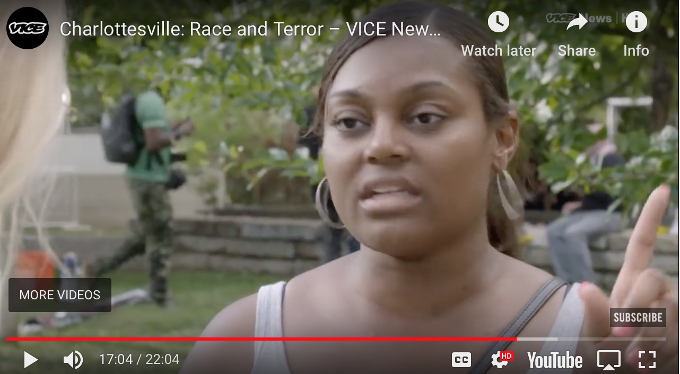
https://www.youtube.com/watch?time_continue=1024&v=RIrcB1sAN8I @16:00
VICE
Published on Aug 14, 2017
On Saturday hundreds of white nationalists, alt-righters, and neo-Nazis traveled to Charlottesville, Virginia to participate in the “Unite the Right” rally. By Saturday evening three people were dead – one protester, and two police officers – and many more injured
“I don’t think it’s ever been about a statue. It’s about right is right and wrong is wrong…This is the face of supremacy,
this is what we deal with every day.

Slide 4
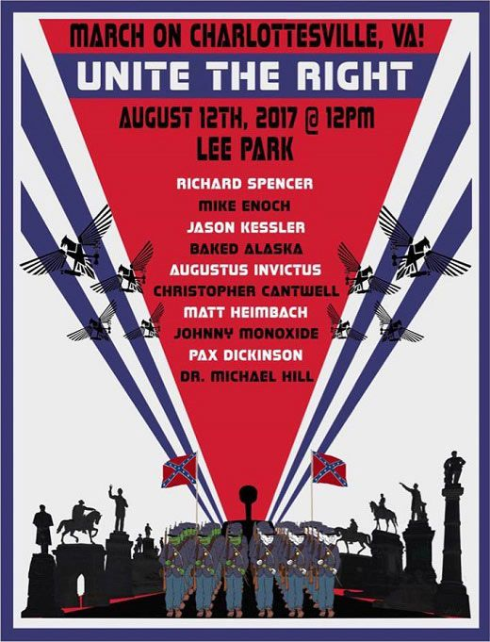
“In short, Unite the Right was organized not by individuals who, in Trump’s words, ‘felt very strongly about the monument to Robert E. Lee,’ but by ardent white supremacists and white nationalists.
On multiple occasions before Unite the Right, attendees stated that the Confederate memorial that was supposedly their purpose was actually the least of their concerns. We have their statements, their videos, their posters, and their words.
We also have the transcript and video of how Trump responded. He did, indeed, refer to the people who attended Unite the Right, people who were likely well aware of and supportive of its messaging, as “very fine people,” and he downplayed the tiki torch parade as “people protesting very quietly.”
Unite the Right was a horrific event in our nation’s recent history — and to come to terms with it requires doing so in good faith and honesty, something the president and his defenders appear unwilling to do.”
https://www.vox.com/2019/4/26/18517980/trump-unite-the-right-racism-defense-charlottesville
Image created for the August 12, 2017 Unite the Right Rally in Charlottesville, VA and approved by Richard Spencer.

Slide 5
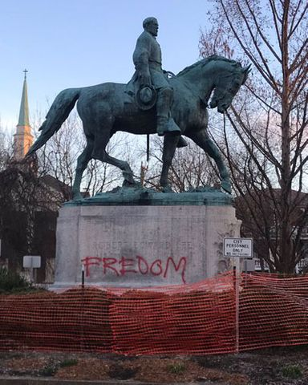
CHARLOTTESVILLE, VA - February 19, 2019
Charlottesville police are investigating vandalism of the statue of Confederate General Robert E. Lee.
February 19. The statue was tagged with graffiti that said "Native Land," and covered in some red paint back in July 2017.
The vandalism came the same day of a settlement conference between groups of people and organizations suing Charlottesville and members of City Council …over an attempt to remove the statues of Lee and General Thomas Johnathan "Stonewall" Jackson. The lawsuit was first filed in Charlottesville Circuit Court back on March 20, 2017, and has undergone amendments and many motions hearings.
Lawyers tell NBC29 that they were unable to resolve their issues during Tuesday’s conference,..” “The parties acted in good faith, but were unable to reach an agreement,” said plaintiffs’ attorney Charles L. Weber, Jr. in a statement. “The negotiations remain confidential; thus, we have no further comment.”
https://www.nbc29.com/story/39986781/lee-statue-02-19-2019

Slide 6
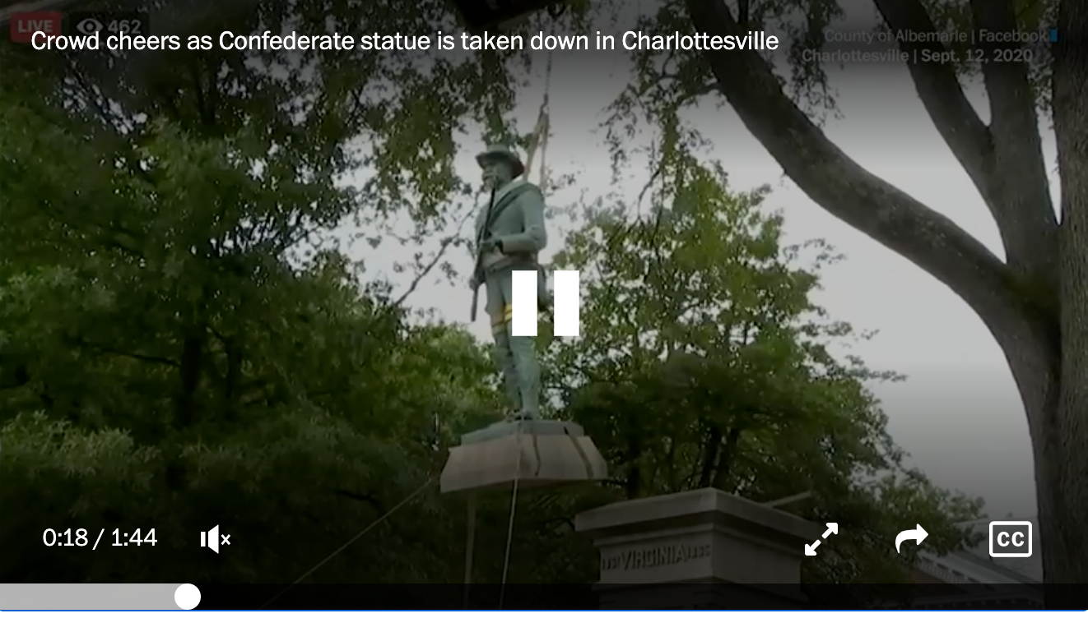
“Confederate statue taken down in Charlottesville near the site of violent 2017 rally”
September 12, 2020. https://www.washingtonpost.com/local/virginia-politics/charlottesville-confederate-statue-removed/2020/09/11/f3f6ee24-f2b4-11ea-b796-2dd09962649c_story.html

Slide 7
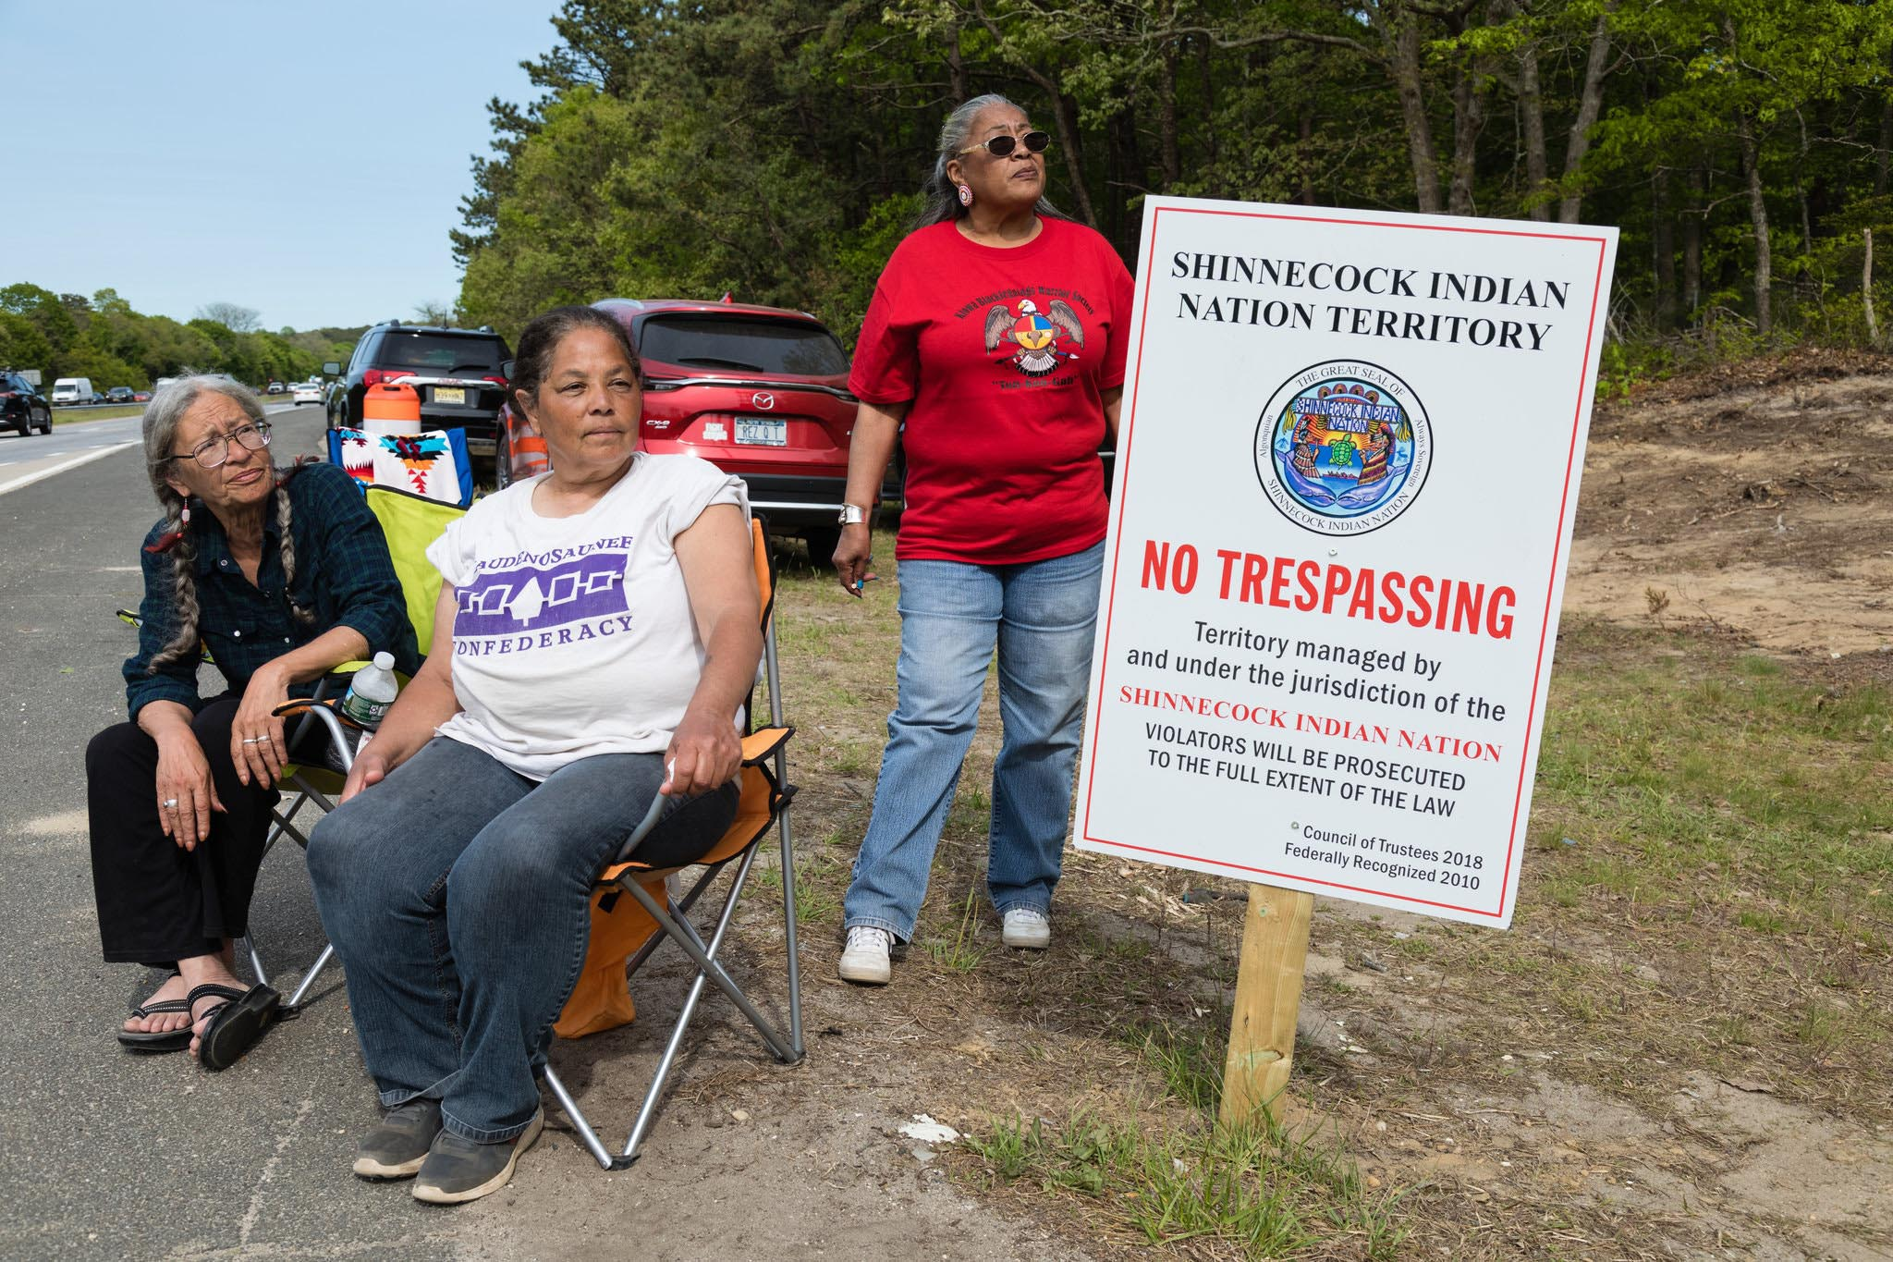
Why a Hamptons Highway Is a Battleground Over Native American Rights
By Corey Kilgannon NYT May 27, 2019
From left, Margo ThunderBird, Rebecca Hill-Genia and Lynda Hunter, members of the Shinnecock Indian Nation, at the site in the Hamptons on Long Island where the tribe is erecting two large electronic billboards. Credit Heather Walsh for The New York Times
https://www.nytimes.com/2019/05/27/nyregion/hamptons-shinnecock-billboards.html

Slide 8
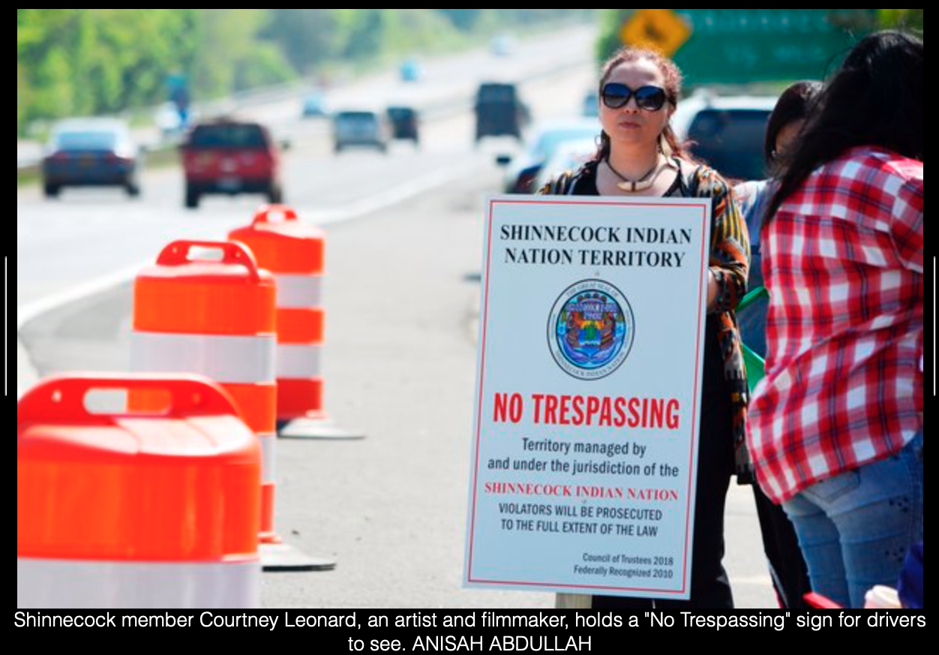
Southampton’s town supervisor - Jay Schneiderman,
The signs “violate the spirit of our local ordinances meant to protect the rural character of the town” and keep the area an attractive escape for New Yorkers, he said.
But the Shinnecock insist that their sovereign status exempts them from any government rules. “We don’t recognize their authority on our sovereign lands,” Mr. Bryan Polite, the Shinnecock Indian Nation’s chairman said.
The signs, which the tribe calls “monuments,” are topped with the Shinnecock’s official seal to make a territorial statement.

Slide 9
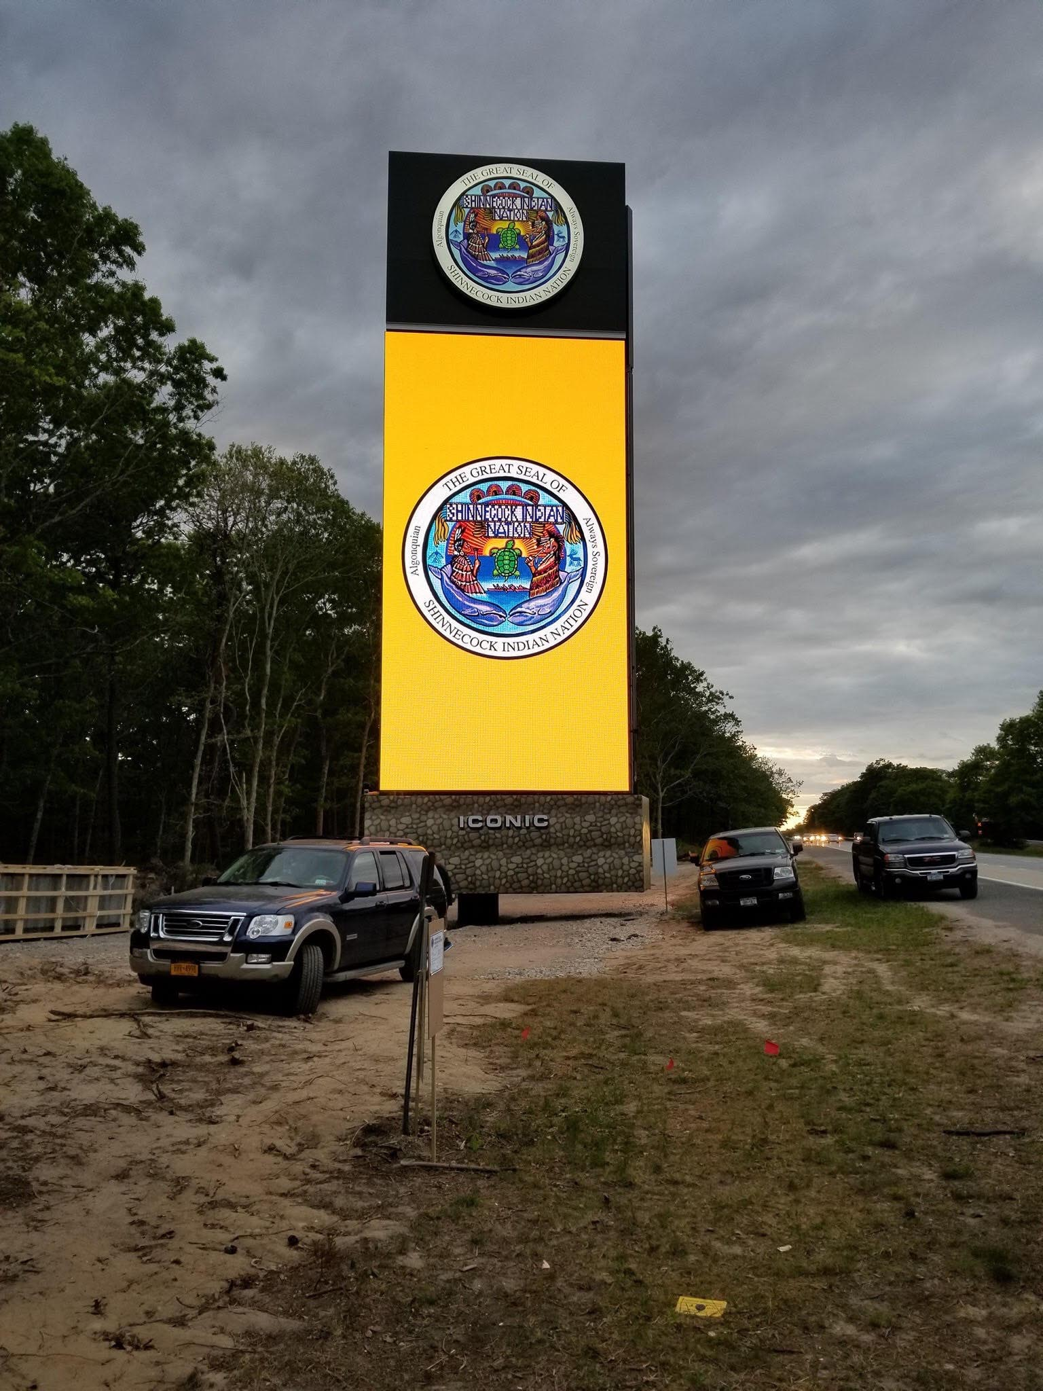
Memory (Memorials) and Forgetting
“It’s a marker of who we are, and to show people that this is our land,” Mr. Polite said. “Yes, there are advertisements on them. But for many of our people who feel like they’ve been forgotten, seeing our tribal seal 60 feet in the air, it’s like we’re visible now,” he said.
When one of the signs was recently completed, members became “very emotional,” Mr. Polite said. “Some of our elders were crying and there was a big sense of pride and euphoria,” he said. “They felt like our ancestors were smiling down on us for these monuments.”
https://www.youtube.com/watch?v=-ipVqEHlsl8
https://www.culturalsurvival.org/news/shinnecock-indian-nation-exercising-its-right-self-determination

Slide 10
@12:00 – 23:20. https://podcasts.ox.ac.uk/terra-foundation-lectures-american-art-2019-contest-images-american-art-culture-war-4

