Slide 1
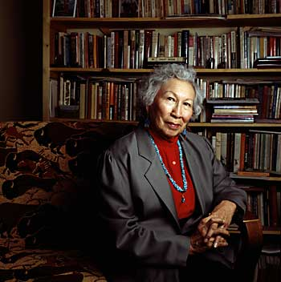
Hinsha Waste Agli Win - Beatrice Medicine (August 1, 1923 - December 19, 2005) (Sihasapa and Minneconjou Lakota) was a scholar, anthropologist, and educator known for her work in the fields of Indigenous languages, cultures, and history. Medicine spent much of her life researching, teaching, and serving Native communities, primarily in the fields of bilingual education, addiction and recovery, mental health, tribal identity, and women's, children's, and LGBT community issues.
Key Themes:
Reflexivity
Applied Anthropology
Self-Determination
LGBTQ advocacy

Slide 2
Reflexivity
The convention of introducing ethnographic works with brief biographical statements, designed to lay out the ethnographer's personal history and stakes in his or her problem or subject. Other works incorporated reflexive concerns or strategies to broader ends, using them to interrogate the relationship between writing and theory or to problematize the role of ethnography in the construction of ethnographic subjects.
https://science.jrank.org/pages/11001/Reflexivity-Reflexivity-in-Anthropology.html

Slide 3
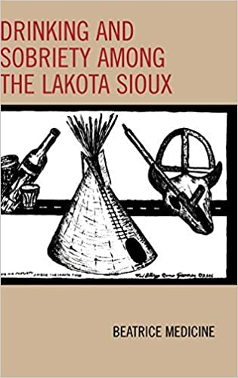
Applied Anthropology
Society for Applied Anthropology was founded in 1941 to promote the investigation of the principles of human behavior and the application of these principles to contemporary issues and problems. The unifying factor is a commitment to making an impact on the quality of life in the world. https://www.appliedanthro.org/
EXAMPLE: Drinking and Sobriety among the Lakota Sioux. By Beatrice Medicine. Lanham, MD: AltaMira Press, 2007
“…there are no social controls on alcoholism or pressures to maintain sobriety within Lakota society. Acts committed while drunk are excusable, and the tiyospaye extended family unit does not shun alcoholics, but supports them with food and shelter in accordance with the cultural weight given to generosity.”
“Medicine argues that to combat alcohol abuse, there must be significant changes in the way Lakota people socialize, and individuals must be able to earn money with dignity.” https://digitalcommons.unl.edu/cgi/viewcontent.cgi?article=1944&context=greatplainsresearch

Slide 4
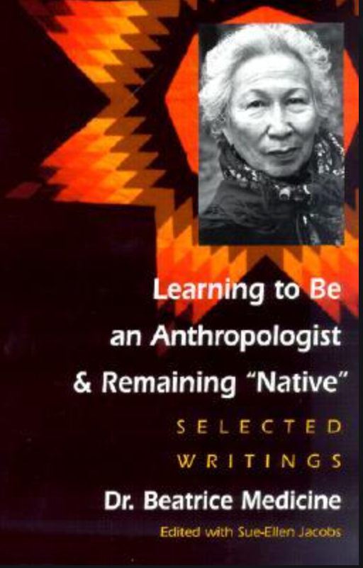
Self-Determination - The period after the late 1960s came to be known as the "Self-determination Era," where U.S. policy toward American Indian tribes provided greater opportunities for Indian people to manage local government and local issues. The Self-determination and Education Act of 1975 (PL-93-638) was passed which allowed tribal governments to contract BIA programs such as police, maintenance, education, social services, etc.
https://www.culturalsurvival.org/publications/cultural-survival-quarterly/self-determination-and-activism-among-american-indians
EXAMPLE: Economic Parity
“Only when Native Americans have equal access to political power, decision-making and socioeconomic advantages will there by any hope of equality for them in their homeland” From Learning to Be an Anthropologist and Remain Native. 2001

Slide 5
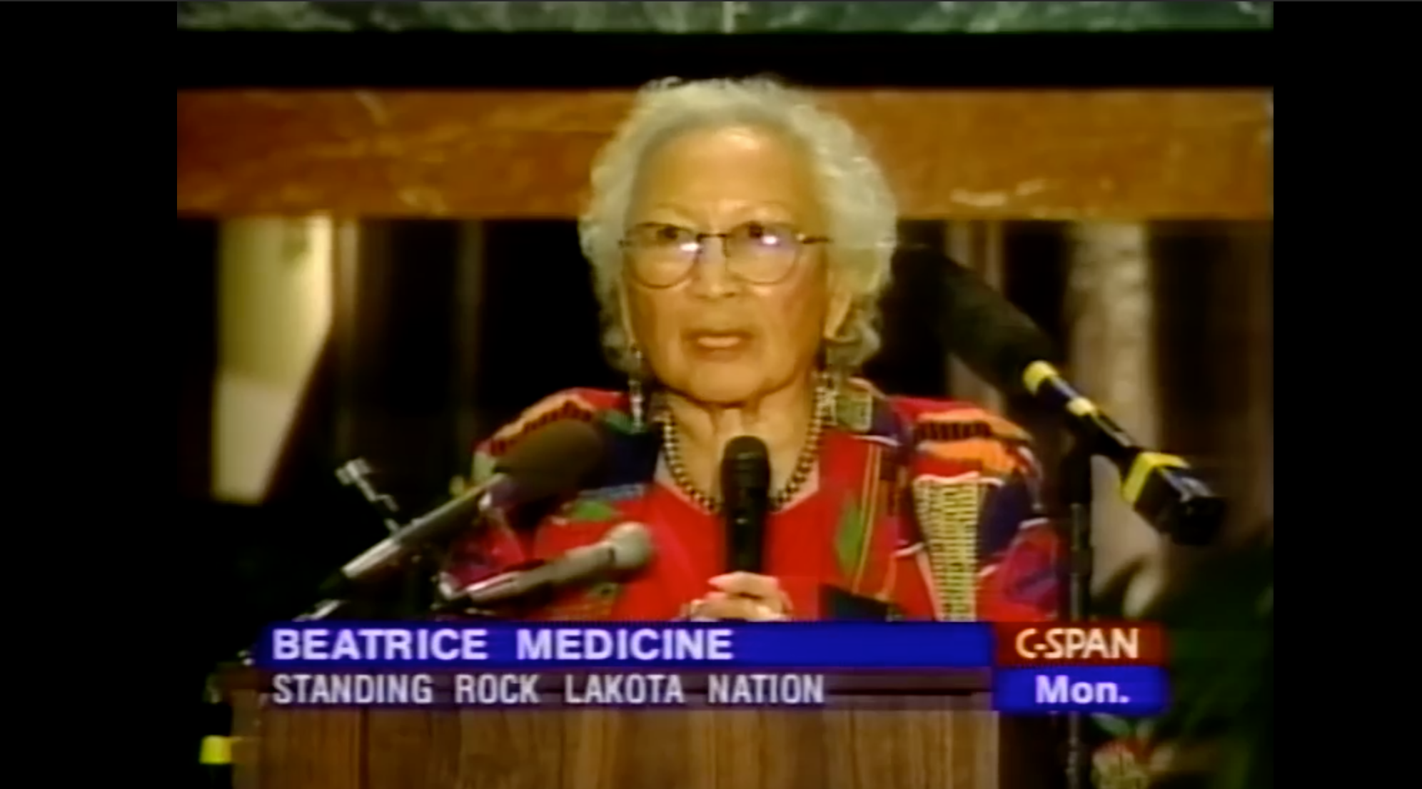
LGBTQ Advocacy
Medicine, Beatrice. (2002). “Directions in Gender Research in American Indian Societies: Two Spirits and Other Categories” In W. J. Lonner, D. L. Dinnel, S. A. Hayes, & D. N. Sattler (Eds.), Online Readings in Psychology and Culture (Unit 3, Chapter 2), Center for Cross-Cultural Research, Western Washington University, Bellingham, Washington USA.
https://www.c-span.org/video/?152556-1/national-gay-lesbian-task-force-dinner @ 15:00
October 4, 1999 National Gay and Lesbian Task Force Dinner – Medicine is 76 years old
See also: https://www.youtube.com/watch?v=W9CWdiYIXH8&feature=emb_logo
BECOMING AN ANTHROPOLOGIST: CELEBRATING DR. BEATRICE MEDICINE’S CONTRIBUTIONS TO ANTHROPOLOGY 2015

Slide 6
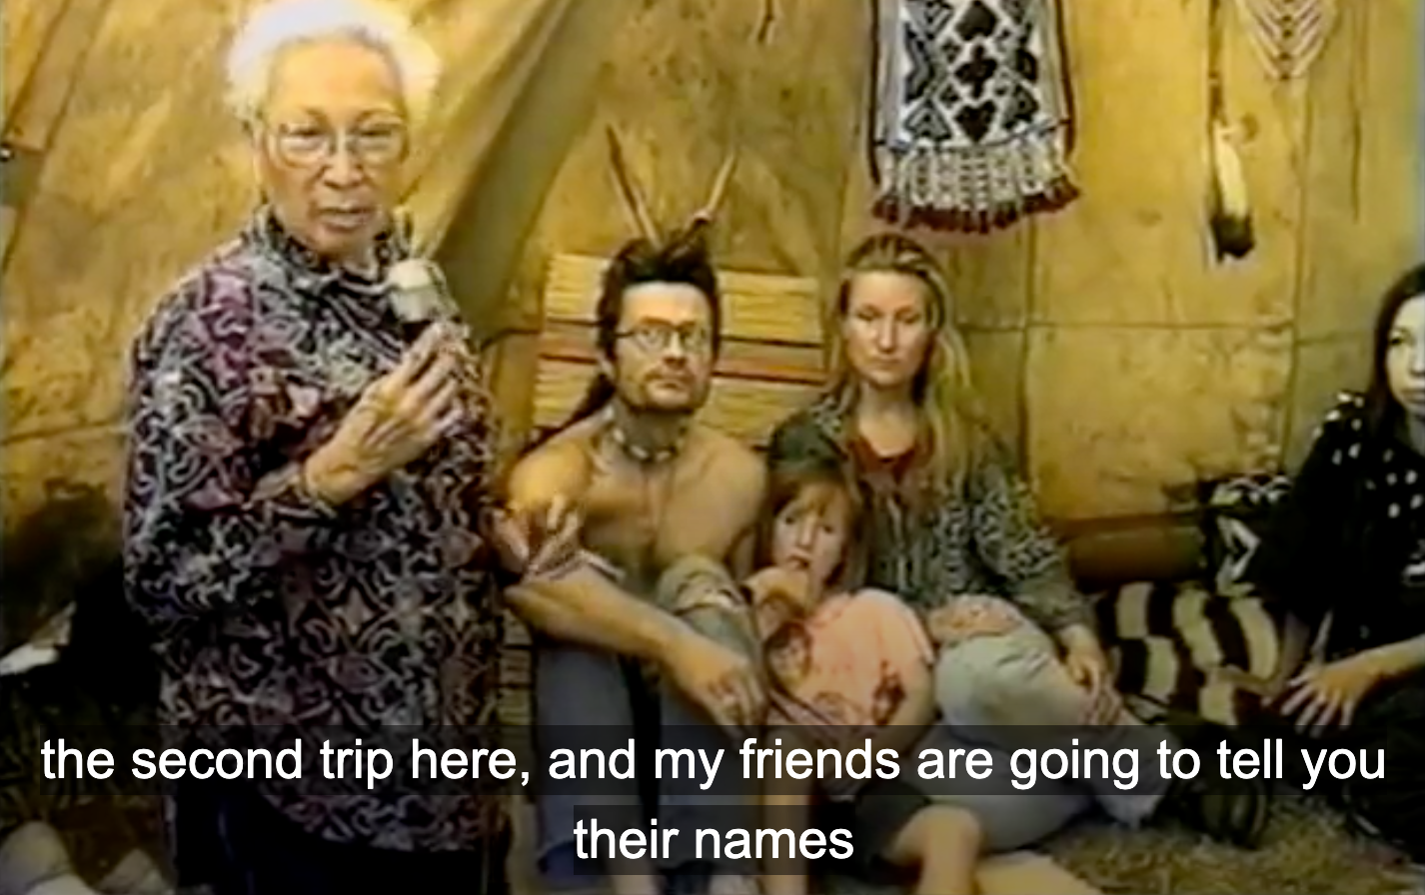
Plains Indians Powwow in Russia produced by Bea Medicine, in “Seeking the Spirit: Plains Indians in Russia” 1999

