Slide 1
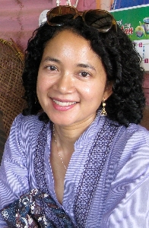
The Third Eye : Race, Cinema and Ethnographic Spectacle (1996)
King Kong (1933) and Nanook of North (1922)
Third Eye – Seeing oneself as an object
It is only by understanding what ethnographic cinema is, and how it works, that the powerful potential of the third eye can be more fully realized.
Double Consciousness - W. E. B. Dubois the "sense of always looking at
one's self through the eyes of others”
Ethnographic cinema - the pervasive "racialization" of indigenous peoples in both popular and traditional scientific cinema. Cinema is a social practice with conventions (nationalism and imperialism) discourse of power, knowledge, pleasure.
Not coeval – Denial of contemporaneity of anthropology and those studied.
Fatimah Rony
Professor, Film & Media Studies School of Humanities UC Irvine Ph.D., Yale University, History of Art M.F.A., UCLA School of Theater, Film, and Television, Directing/Production

Slide 2
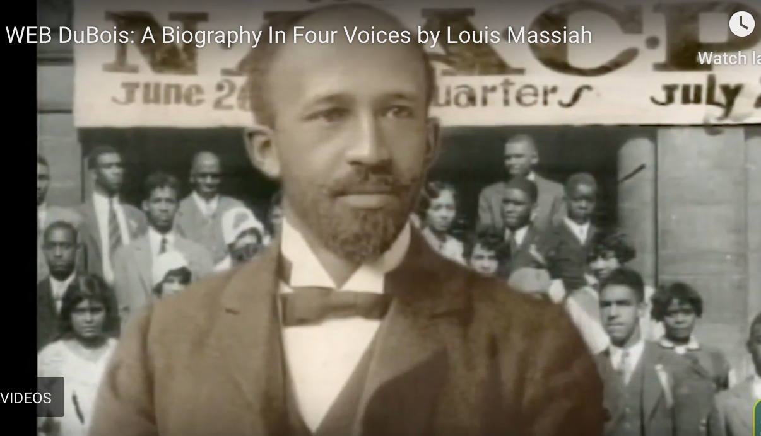
https://scribe.org/catalogue/web-du-bois-biography-four-voices
W.E.B. DuBois American sociologist, historian, civil rights activist (1868-1963)

Slide 3
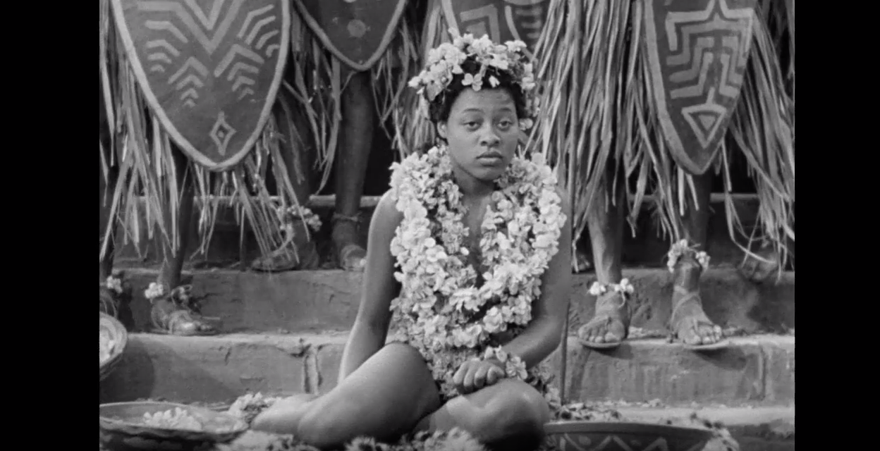
https://www.youtube.com/watch?v=s8oTYGhLNG4&list=PLm8wLl-CegPCDuAkT5bZ1blKkq7DKVzd_&index=36
Bride of King Kong, 1933
Fascinating cannibalism - The obsessive consumption of the racialized other known as the
Primitive
The Western civilized self was constituted in part through this confrontation with and picturing of the savage or primitive other.
Ethnographiable monster, the fear of the hybrid as monster

Slide 4
Rony’s strategies:
1) Open resistance
2) Recontextualization
3) Parody
4) Restraint (Resistance
Refusal)
Kerry James Marshall:
Reduction
Isolation
Lisa Reihana:
Futurism
Methods of representation
Juxtaposition
Inversion
Documentary
Primary sources
Expert witnesses
Emotions
Children
Music
Repetition
Written Language
Dreamscape – “magical realism”
Symbolism
Humor

Slide 5
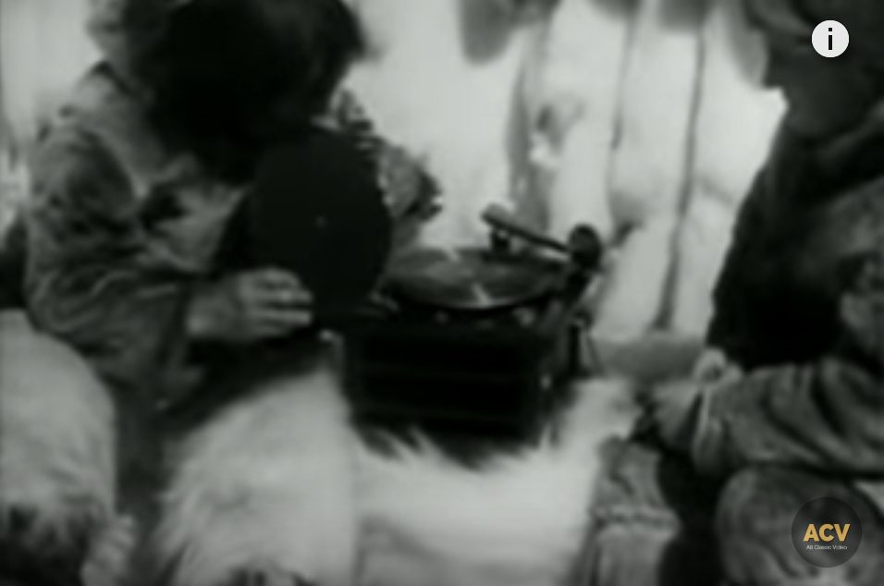
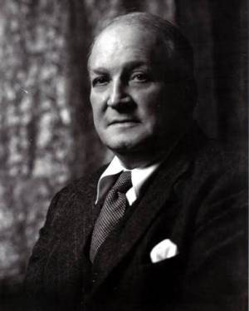
Flaherty is generally considered the father of American documentary filmmaking (1884-1951)
Nanook of the North 1922
https://www.youtube.com/watch?v=m4kOIzMqso0

Slide 6
In a 1990 documentary titled “Nanook Revisited” that does aspire to historical accuracy and that is unfortunately only available from research libraries today, the production team went to Inukjuak, the village in northern Quebec where Flaherty shot his film, to interview relatives of Nanook’s contemporaries as well as knowledgeable villagers. The manager of the local television station Moses Nowkawalk was both amused and annoyed by inaccuracies. For example, Flaherty had Nanook looking mystified by a phonograph player and taking a bite out of a record but Nowkawalk points out that the villagers had been listening to records for years.
The greatest fiction of all were the characters themselves, who understood that they were actors in a drama built on the premise that they were living the lives of their ancestors. Nanook, which means hunter in the Inuit language, was actually named Allakariallak. His two wives in the film were not really his. Instead, during the course of filming they became Flaherty’s mistresses, one giving birth to his son Josephie with whom Flaherty never made contact.
https://ffh.films.com/PreviewClip.aspx?id=2983&trackingID=BVL
https://louisproyect.org/2016/04/02/nanook-of-the-north-revisited/

Slide 7
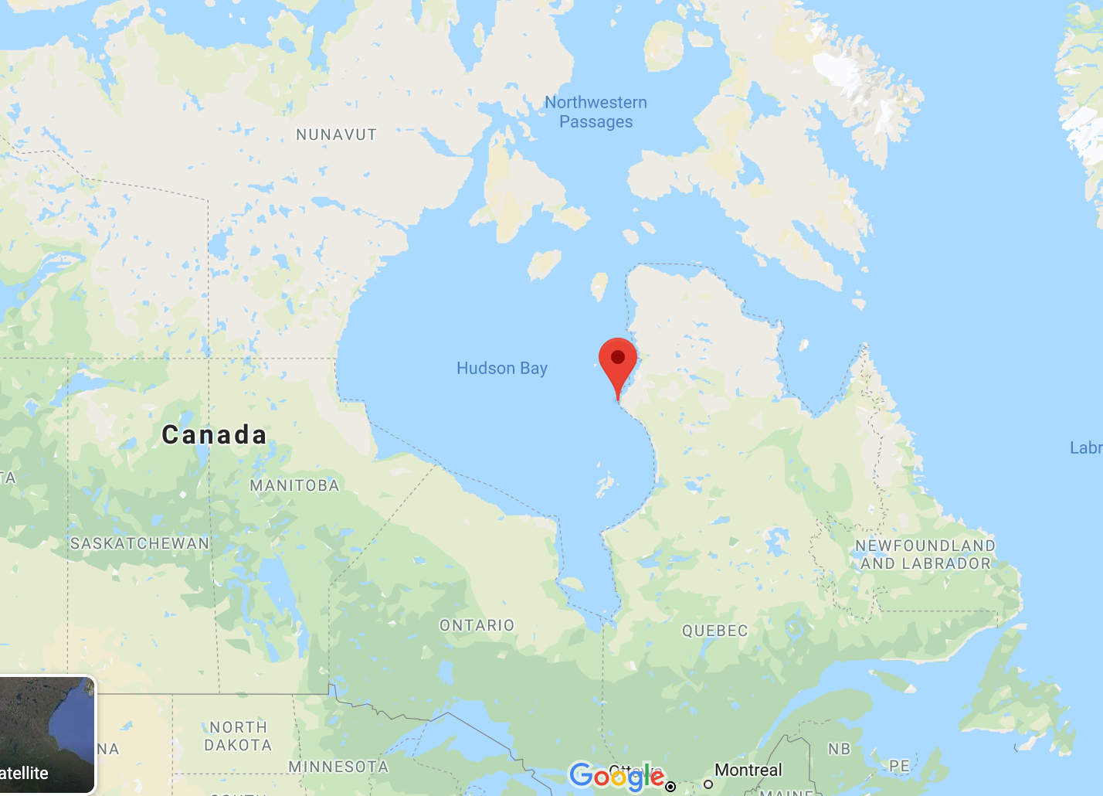

Slide 8
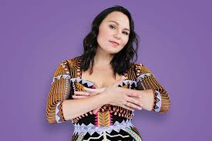
Tanya Tagaq "Uja" and "Umingmak" (live) -- Polaris Music Prize 2014
Inuk Throat singer from Nunavut Province Canada (1975- )
Rony strategies to speak back:
1) Open resistance
2) Recontextualization
3) Parody
4) Restraint
https://www.youtube.com/watch?time_continue=90&v=FcOYx4_72Zo&feature=emb_logo
Retribution: https://www.youtube.com/watch?v=xNYTA6SV6tM

Slide 9
What is an archive and why is it so important?
Take 7-10 minutes and write your thoughts about your own experience with an archive. You do not need to place your name on your response.
Your own archive – family photos, your papers
A relative’s archive – your mother’s or father’s or grandparent’s papers or photos
An “official” archive –school, community, museum
After you finish writing we will exchange responses and discuss.

Slide 10
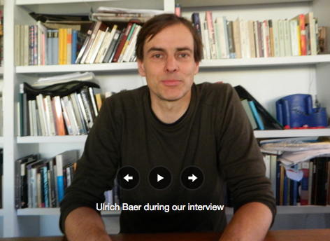
Ulrich Baer
The photographic archive as melancholic but also offers the possibility of “opening up new worlds, of offering new historical identities.”
ULRICH BAER is Professor of German and Comparative Literature at New York University. He is the author of Spectral Evidence: The Photography of Trauma, 110 Stories: New York Writes after 9/11, and Remnants of Song: Trauma and the Experience of Modernity in Charles Baudelaire and Paul Celan

Slide 11
- The original intention of recording for the future becomes clouded by melancholia
The archive seems to tinge its subject with death: what is found in the archive bears testimony to everything that could not be collected but was lost
Archives bestow legitimacy and preserve certain forms of knowledge
Archives transmit culturally and historically specific modes of remembrance.
But even in dogmatically conceived and tightly controlled archives there is an opening.
Photographs like archives have the capacity of contingent, accidental or strategic interpretations.
ONLY interpreting the archive as as evidence of trauma (melancholy) is limiting. Alternatives for new life in the archive and the photo.

Slide 12
Three Modes of Artistic Engagement in the Archive
The fabricated or constructed archive
The archive of the unremembered
The archive’s redemption for new life
To conduct research in an archive means to acknowledge that something contained therein might also undo the question that brought us here in the first place.

Slide 13
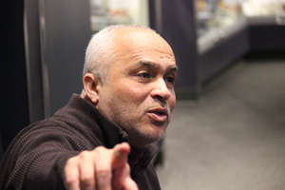
Brothers by David Pilgrim
https://www.youtube.com/watch?v=WTr5ql27CNQ
Pilgrim is an applied sociologist with a doctorate from The Ohio State University. He believes that racism can be objectively studied and creatively assailed. He is the founder and curator of the Jim Crow Museum-a 12,000 piece collection of racist artifacts located at Ferris State University. The museum uses objects of intolerance to teach tolerance and promote social justice.

Slide 14
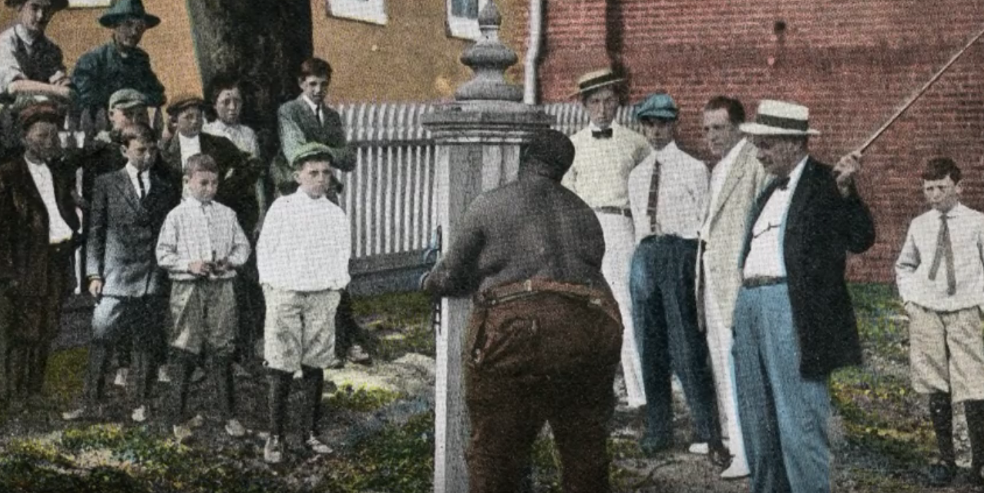

Slide 15
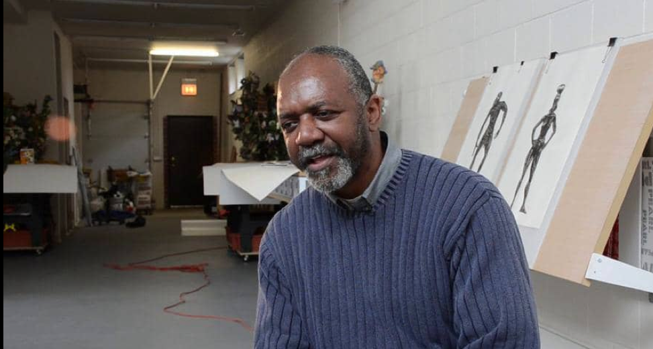
Kerry James Marshall: Heirlooms and Accessories – Reduction, Isolation
https://vimeo.com/45605233

Slide 16
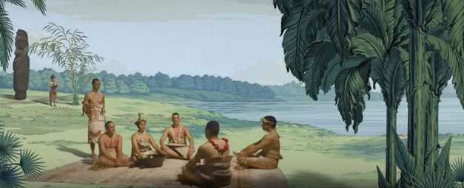
New Zealand - Lisa Reihana - Emissaries (In Pursuit of Venus [infected]) - Venice Biennale 2017
Futurism
https://www.youtube.com/watch?v=TEZQ-O4vihY

