Slide 1
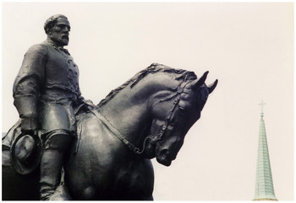
1) In 2015, the white supremacist Dylann Roof murdered nine African Americans at the Emanuel African Methodist Episcopal Church in Charleston, South Carolina. Pictures surfaced of Roof holding a Confederate battle flag, prompting debate over the flag's meaning, a debate that eventually expanded to Confederate monuments.
2) In March 2016, Charlottesville's vice mayor, Wes Bellamy, proposed the Robert E. Lee statue be removed. Zyahna Bryant, a fifteen-year-old student at Charlottesville High School, initiated a petition that decried the statue's "selective display of history" and also called for its removal. A counter petition proposed keeping the statues and adding another in honor of Julian Bond, a civil rights leader and professor at the University of Virginia.
3) In 2017 hundreds of white nationalists, alt-righters, and neo-Nazis traveled to Charlottesville, Virginia to participate in the “Unite the Right” rally. By Saturday evening three people were dead – one protester, and two police officers – and many more injured
https://www.encyclopediavirginia.org/Robert_Edward_Lee_Sculpture#start_entry

Slide 2
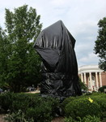
While the war and the ratification of the 13th amendment officially ended the enslavement of African Americans, the period from the 1880s until the 1930s witnessed the retrenchment of white supremacy across the South. State legislatures passed Jim Crow segregation laws and disfranchised black voters, white mobs lynched thousands of black men, and President Woodrow Wilson re-segregated the federal government. At the same time, monuments to figures such as Robert E. Lee (unveiled on May 21, 1924) and Thomas “Stonewall” Jackson who in 1921 also received a park and statue in Charlottesville, helped underscore the importance of Confederate heritage and its touchstone, white supremacy.
Both Lee and Jackson parks were strictly whites-only according to the terms of McIntire's deeds to the city, and just days before the unveiling of the Lee monument the local Ku Klux Klan burned a large cross on Patterson's Mountain near Charlottesville and then paraded through the city.
Lee Sculpture Covered in Tarp
A judge ordered the coverings removed in February 2018. That summer, the city renamed Lee and Jackson parks for a second time since the violence of the year before, from Emancipation and Justice parks, respectively, to Market Street and Court Square parks.

Slide 3
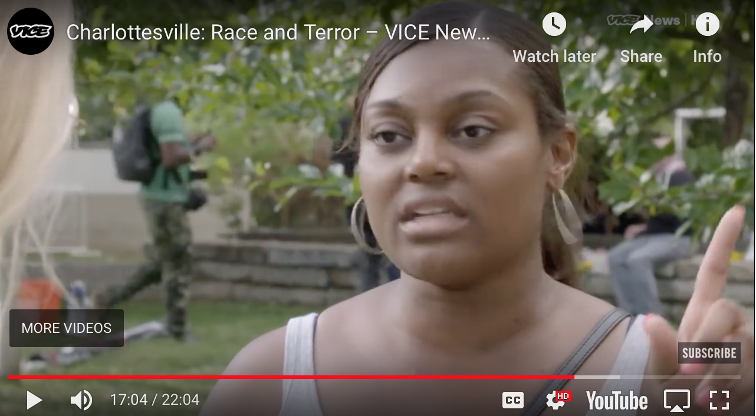
https://www.youtube.com/watch?time_continue=1024&v=RIrcB1sAN8I @16:00

Slide 4
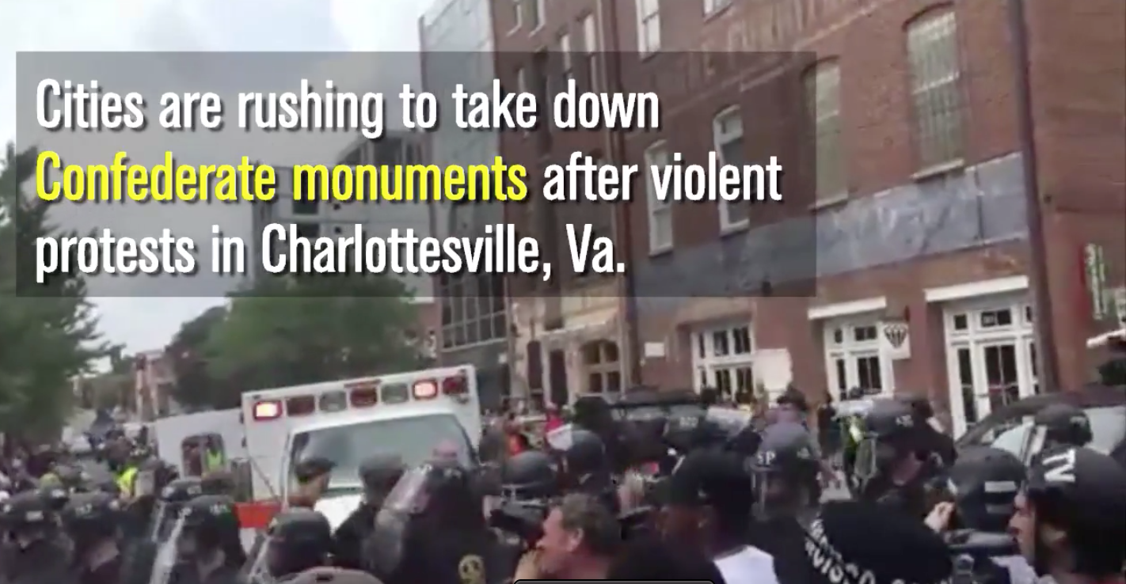
https://www.chicagotribune.com/94343325-132.html
Some removals were highly contentious, such as in Charlottesville, Virginia, where hundreds of white supremacists staged a deadly rally last August to protest the planned removal of a prominent statue of Robert E. Lee.

Slide 5
The Southern Poverty Law Center, based in Montgomery, Ala., is a nonprofit civil rights organization founded in 1971 and dedicated to fighting hate and bigotry, and to seeking justice for the most vulnerable members of society.
Responding to Objections and Myths WHOSE HERITAGE? (2016, updated in 2019)
CLAIM: It’s heritage not hate.
RESPONSE: While some people see Confederate symbols as emblems of Southern pride and heritage, the question must be asked: Whose heritage?
The “heritage, not hate” argument ignores the near-universal heritage of African Americans who were enslaved by the millions in the South and later subjected to brutal oppression under the white supremacist regime of Jim Crow. Our democracy is based on equality under the law, and public entities should not prominently display symbols that undermine that concept and alienate an entire segment of the population.
https://www.splcenter.org/sites/default/files/com_whose_heritage.pdf

Slide 6
https://www.splcenter.org/sites/default/files/com_whose_heritage_timeline_print.pdf
The report identifies two distinct periods that saw a significant rise in the dedication of monuments and other symbols. The first began around 1900, amid the period in which Southern states were enacting Jim Crow laws to disenfranchise the newly freed African Americans and re-segregate society. The second began in the early 1950s and lasted through the 1960s, as the civil rights movement led to a backlash among segregationists.

Slide 7
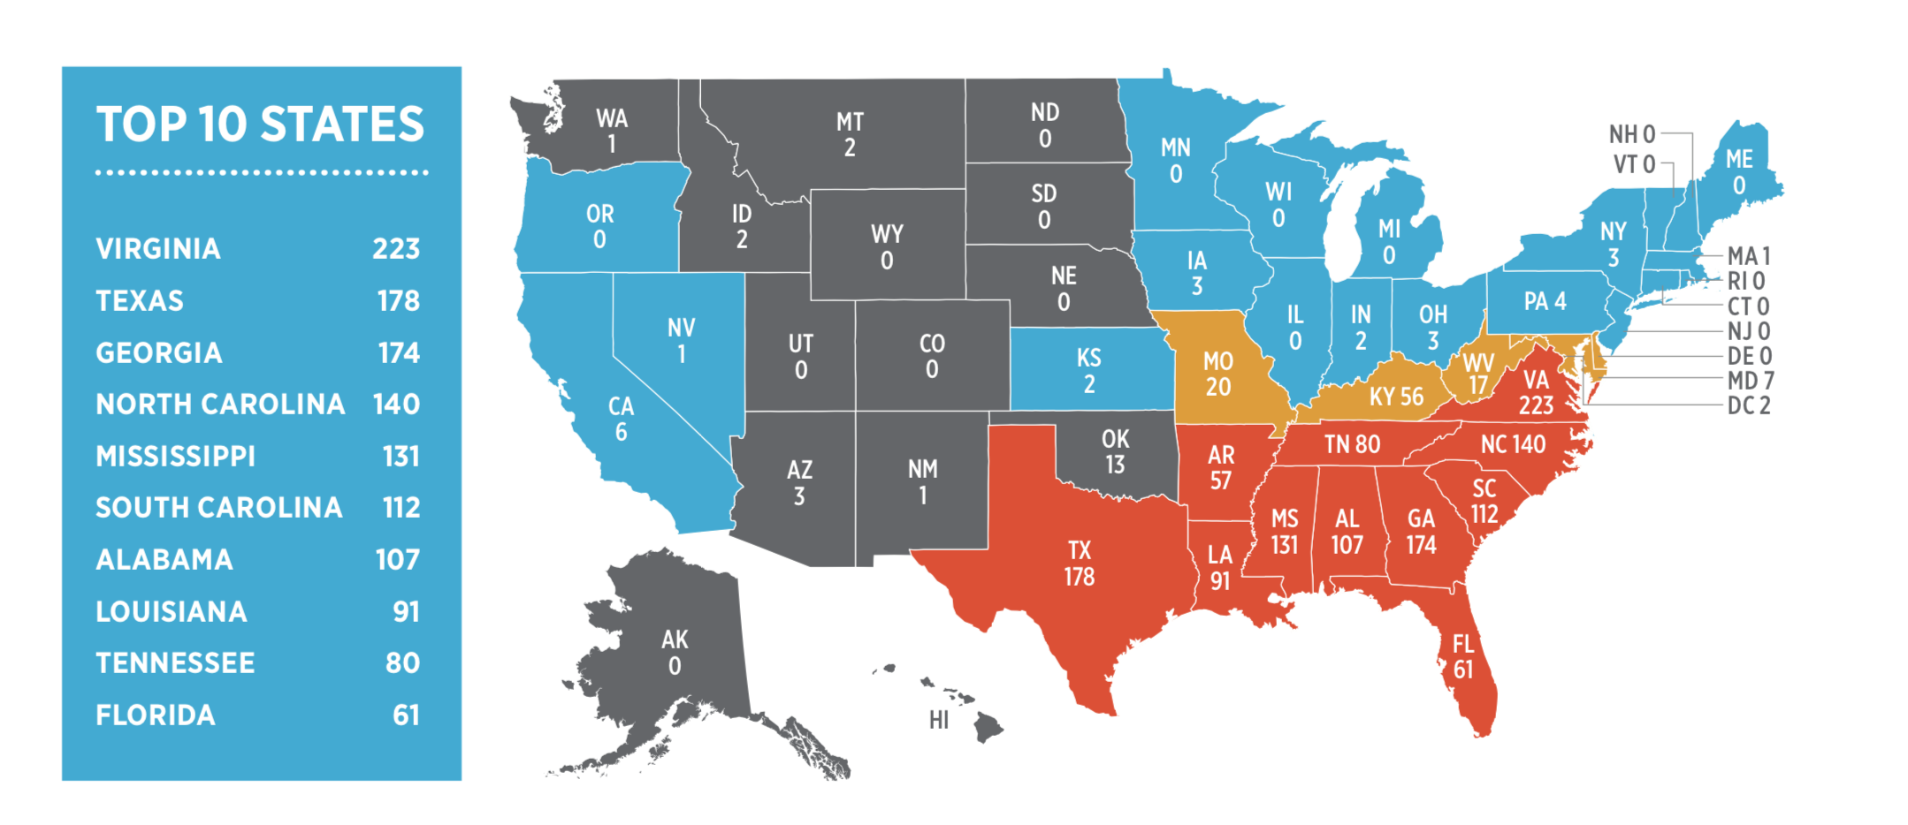
https://www.splcenter.org/sites/default/files/com_whose_heritage.pdf

Slide 8
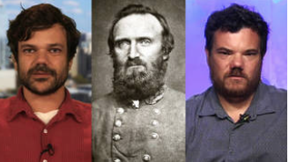
Stonewall Jackson’s Great-Great-Grandsons Call for Removal of Confederate Monuments
https://www.democracynow.org/2017/9/4/stonewall_jacksons_great_great_grandsons_call

Slide 9
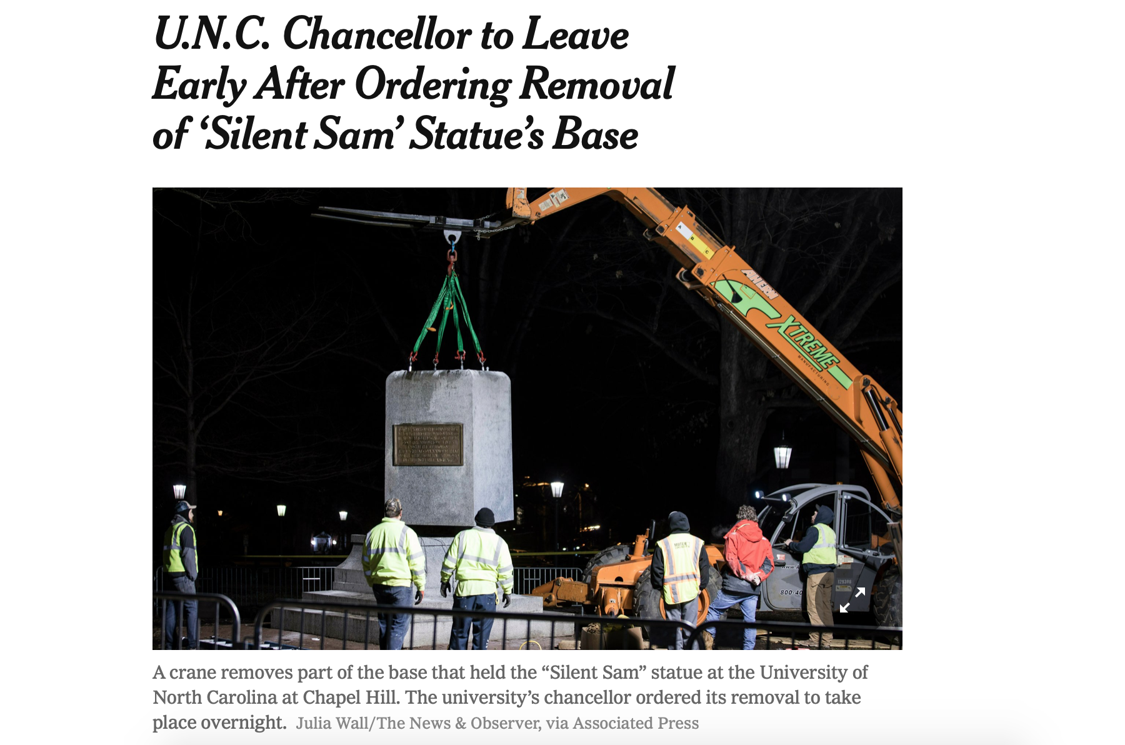

Slide 10
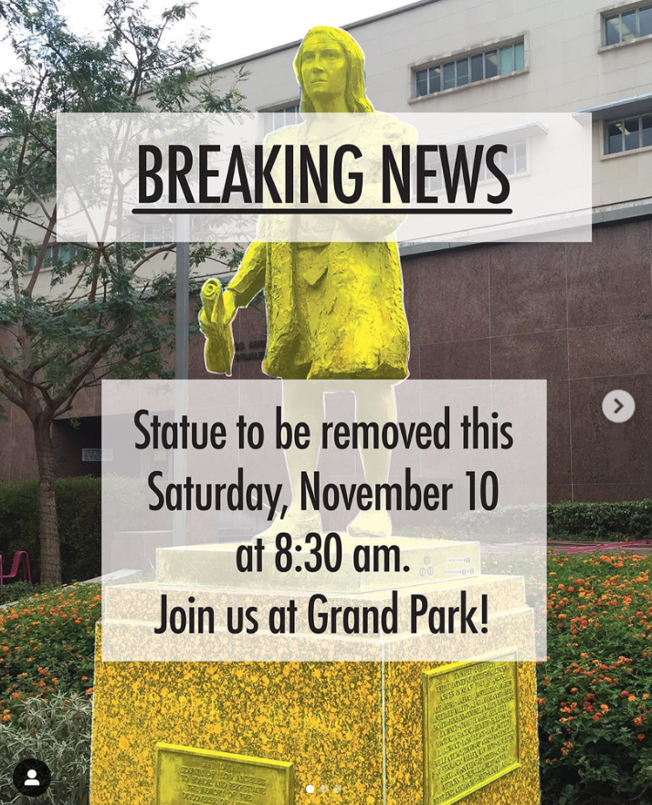
In October, the bronze statue depicting Christopher Columbus at Grand Park was completely hidden from view during Los Angeles’ inaugural celebration of Indigenous Peoples Day. Today it was announced that the statue will be permanently removed on Saturday, November 10, 2018.

Slide 11
Tatzu Nishi: Discovering Columbus, 2012
https://vimeo.com/65566692

Slide 12
Words to describe the Nishi Artistic Rendering with the Columbus Monument
Minimize Interactive
Domesticate Intimate
Changing power dynamic Shift in power relations
Objectify Satire – consumerism
Consent – Agency Intervention
Remembrance Demographics
Look for patterns – eradication, re-appropriation, inversion

