Slide 1
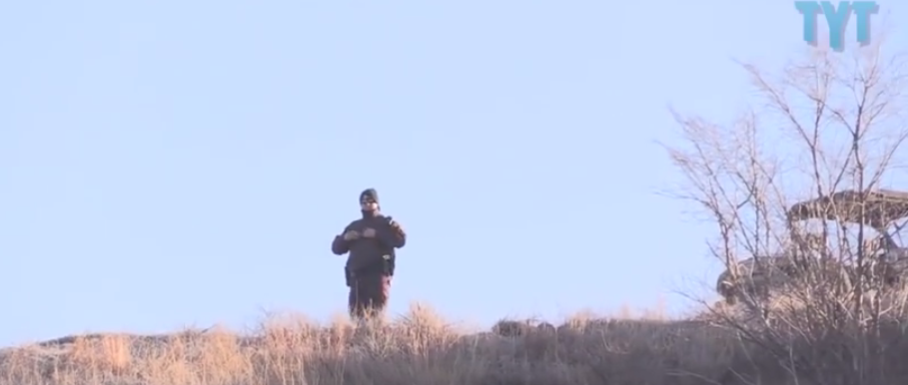
DAPL Builds Razor Wire Wall On Native Burial Ground
DAPL: https://www.youtube.com/watch?v=eYXFtX8kfa0
TYT Politics Reporter Jordan Chariton on media coverage: https://www.youtube.com/watch?v=YCwIvRDRSVo&t=524s

Slide 2
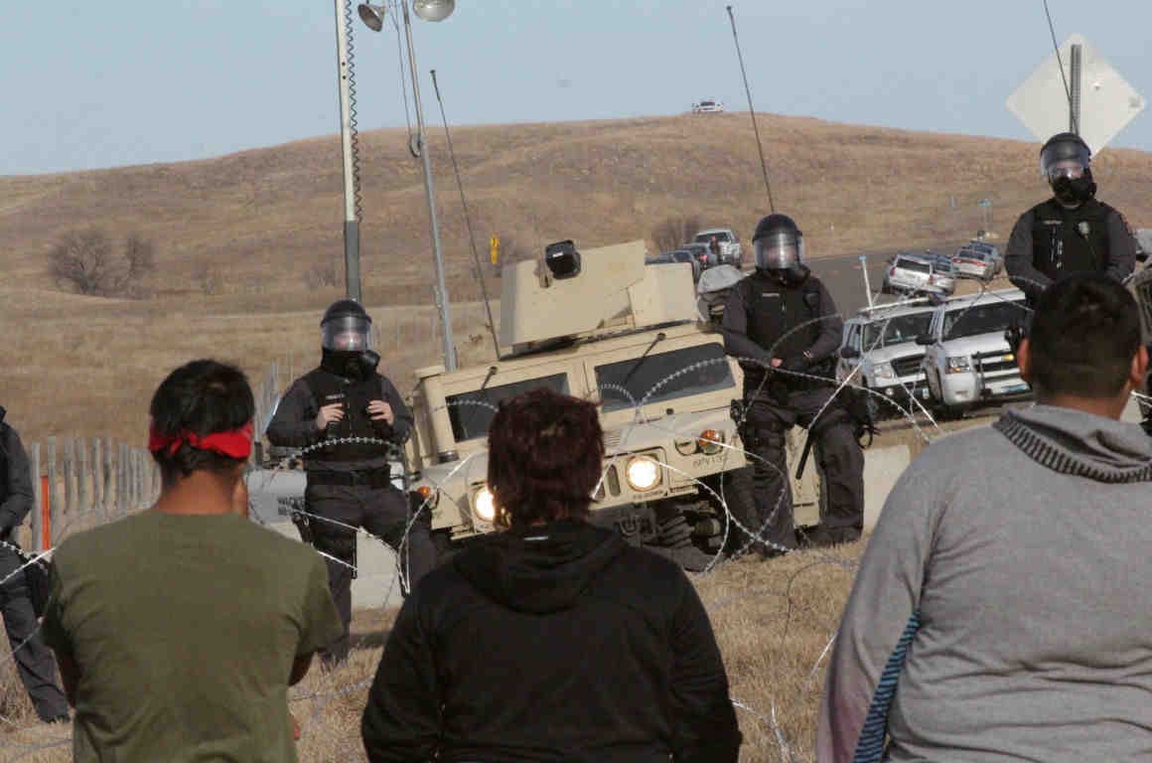
Police at Standing Rock Are Using Life-Threatening Crowd-Control Weapons to Crack Down on Water Protectors
https://soundcloud.com/dallas-goldtooth
To make matters worse, the atrocious use of excessive and disproportionate police force is imperceptibly softened by news outlets that frame Sunday’s confrontations as a “clash.” It suggests there is an equal balance of power between the militarized police force and weaponless demonstrators. This is no “clash.”
It is a catastrophe with serious human rights implications. Nearing the eve of Thanksgiving, a holiday remembered by many indigenous peoples for its legacy of American colonization and genocide, Sunday’s showdown is a contemporary illustration of an age-old oppression that this country must reckon with. https://www.aclu.org/blog/speak-freely/police-standing-rock-are-using-life-threatening-crowd-control-weapons-crack-down

Slide 3
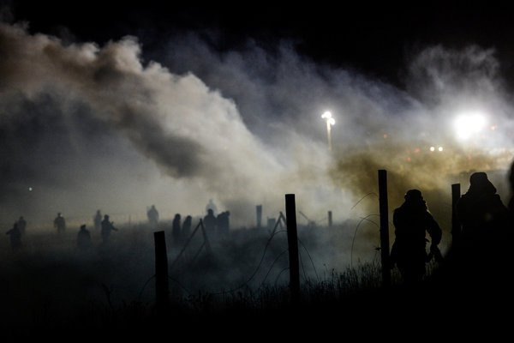
Power Imbalance at the Pipeline Protest
NYT 11.23.16
“How can this possibly end well?”
The department’s video was meant to portray the protesters as dangerous troublemakers, but the photos and videos in news reports suggest a more familiar story — an imbalance of power, where law enforcement fiercely defends property rights against protesters’ claims of environmental protection and the rights of indigenous people. American Indians have seen this sort of drama unfold for centuries — native demands meeting brute force against a backdrop of folly — in this case, the pursuit of fossil fuels at a time of sagging oil demand and global climatic peril. NYT 11.23.16 http://mobile.nytimes.com/2016/11/23/opinion/power-imbalance-at-the-pipeline-protest.html?referer=https%3A%2F%2Fwww.google.ca%2Fsearch%3Fq%3Dnew+york+times%2Bstanding+rock&oq=new+york+times%2Bstanding+rock&gs_l=mobile-heirloom-serp.3...6709.95726.0.96990.35.25.1.9.9.0.478.3671.1j23j4-1.25.0....0...1c.1.34.mobile-heirloom-serp..2.33.3723.RaCpyUA5J_k

Slide 4
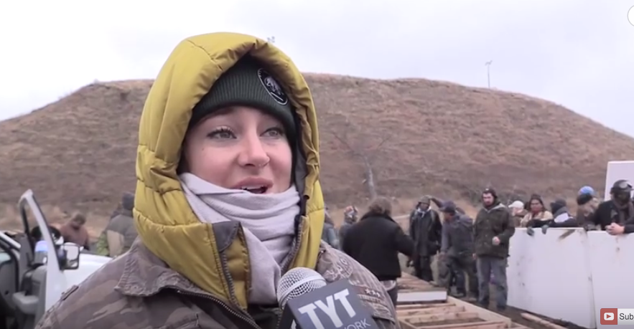
Shailene Woodley On Taking Responsibility For White Supremacy
https://www.youtube.com/watch?v=TpbMIQkCFXs
https://www.youtube.com/watch?v=VNivVVf-oM4

Slide 5
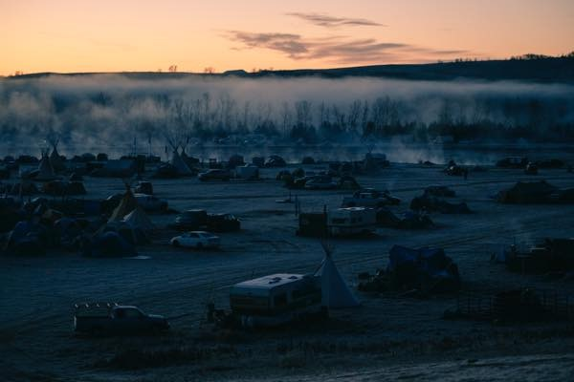
How to Give, and to Give Thanks, to Standing Rock
http://indiancountrytodaymedianetwork.com/2016/11/23/how-give-and-give-thanks-standing-rock-166566?mc_cid=e780c06087&mc_eid=bcb75a312f

Slide 6
Cannupa Hanska Luger
https://vimeo.com/191394747
http://theartnewspaper.com/news/artist-creates-mirrored-shields-for-standing-rock-protesters/
http://www.bbc.co.uk/programmes/p04hwgkg

Slide 7
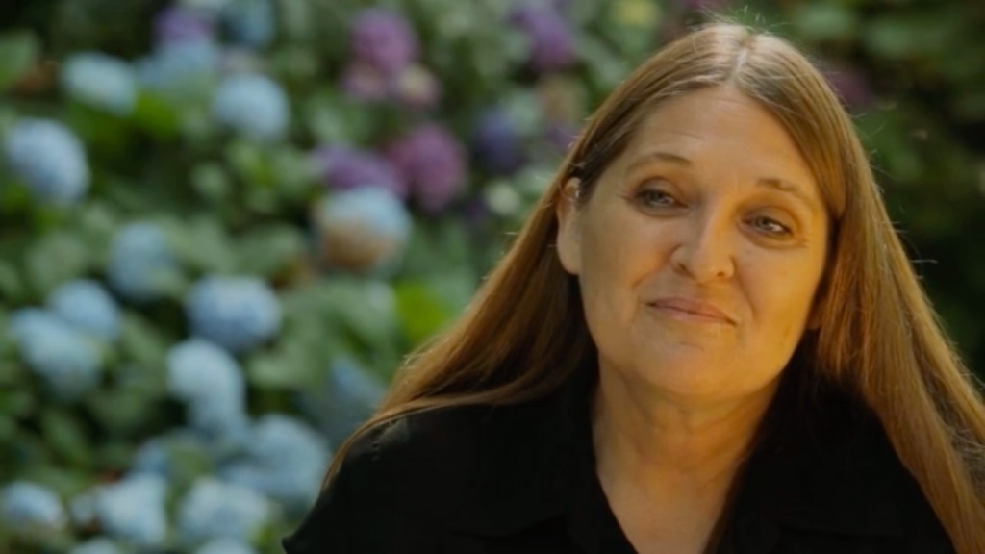
“American I Sing You Back”
Allison Adelle Hedge Coke is a poet, performer, teacher and literary activist. She currently teaches at the University of California Riverside.
http://www.pbs.org/newshour/poetry/america-sing-back/
Notes:
Allison Adelle Hedge Coke considers her poem “America, I Sing You Back” to be an extension of two famous poems about the identity of America: Walt Whitman’s “I Hear America Singing” and Langston Hughes’ “I, Too”.
“Those poems were written by men— one white and one black— and I wanted to represent the voice of a woman, and an indigenous person. We all see our country from different perspectives culturally.”
Indigenous people want to see harmony restored to the Earth, said Coke, who is of mixed heritage. Hedge Coke uses the imagery of a mother singing to her child, and then waiting for the child to mature and enter a time of reason.

