Slide 1
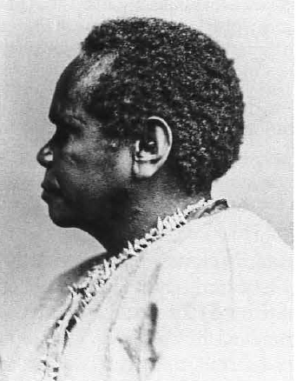
The Anthropological Project and Photographic “Types”
A form of portrait photography characterized as being from the mid 1800s and of broad interest to anthropology and ethnology
in their attempts to define and classify the physical nature and origin of human races, and by implication their culture.
Profile of Tasm.anian woman Bessie Clarke. One of a series taken for the Tasmanian display at the Intercolonial Exhibition in Melbourne, Australia. Photograph by C.A. Woolley, Hobart, 1866. Pitt Rivers Museum, University of Oxford, B44.16A.
Notes:
Edwards, Elizabeth. 1990. “The Image as Anthropological Document: Photographic ‘Types’ The Pursuit of Method.” Visual Anthropology, 3:235-258.

Slide 2
1) Necessary to consider the science of anthropology in general and the study of race in particular within contemporary socio-political frameworks
2) Evolutionary theory - Races were seen as forming a natural but static chain of excellence in human kind, representing differing stages in the evolution of the species, of which the northern Caucasian was the highest and the Negro the lowest; further, cultural diversity was seen largely as being biologically determined.
3) There was considered a correlation between physical nature and mental ability.
4) Within the evolutionary structure the fixity of races had particular importance in the establishment of the notion of "types" which were the essence of classificatory method.
5) The production of photographs of anthropological interest was largely outside the intellectual control of those who sought to use them as evidence. A large proportion were produced by professional photographers making images for European consumption. Given that the photographer controls the image produced in terms of his or her own perceptions, beliefs, and visual vocabulary, attitudes towards the nature of primitive man and race permeated the production of contemporary anthropological photography. Many of the beliefs and ensuing discussions which occupied the anthropological interests of the day were widely circulated in popular and often vulgarized form. They provided the subject of cartoons, newspaper articles, and popular lectures.
Notes:
Edwards, Elizabeth. 1990. “The Image as Anthropological Document: Photographic ‘Types’ The Pursuit of Method.” Visual Anthropology, 3:235-258.

Slide 3
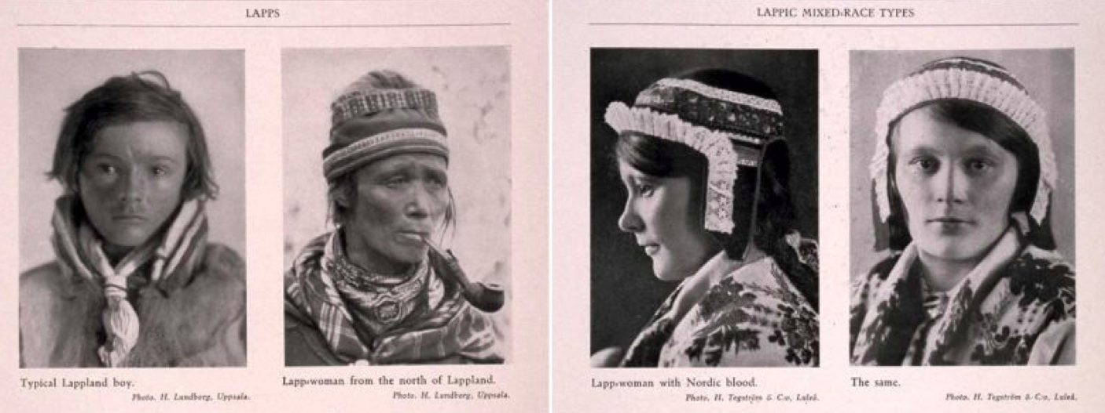
Notes:
https://kristendobbin.atavist.com/visualrepatriation

Slide 4
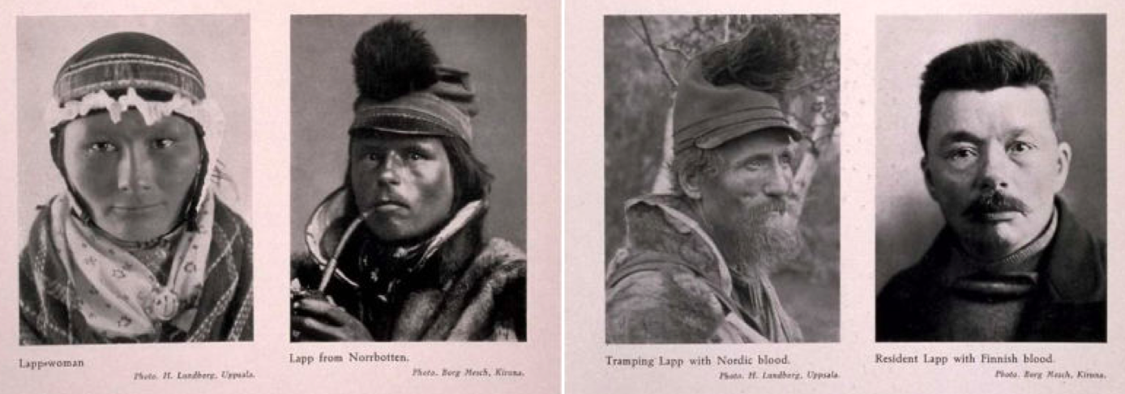

Slide 5
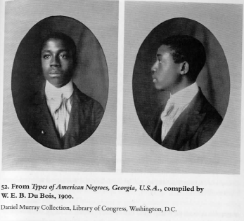
At the turn of the last century, W. E. B. Du Bois compiled a series of photographs for the "American Negro" exhibit at the 1900 Paris Exposition. He organized the 363 images into albums, entitled Types of American Negroes, Georgia, U.S.A. and Negro Life in Georgia, U.S.A..
At the time, Du Bois was a professor of sociology at Atlanta University, committed to combating racism with empirical evidence of the economic, social, and cultural conditions of African Americans. He believed that a clear revelation of the facts of African American life and culture would challenge the claims of biological race scientists influential at the time, which proposed that African Americans were inherently inferior to Anglo-Americans. The photographs of affluent young African American men and women challenged the scientific "evidence" and popular racist caricatures of the day that ridiculed and sought to diminish African American social and economic success. Further, the wide range of hair styles and skin tones represented in the photographs demonstrated that the so-called "Negro type" was in fact a diverse group of distinct individuals.
Notes:
Smith, Shawn Michelle. 2012 “’Looking at One’s Self through the Eyes of Others’ W.E.B. Du Bois’s Photographs for the Paris Exposition of 1900.” In Pictures and Progress, Early Photography and the Making of African American Identity, edited by Maurice O. Wallace and Shawn Michelle Smith, 274-298. Durham: Duke University Press.

Slide 6
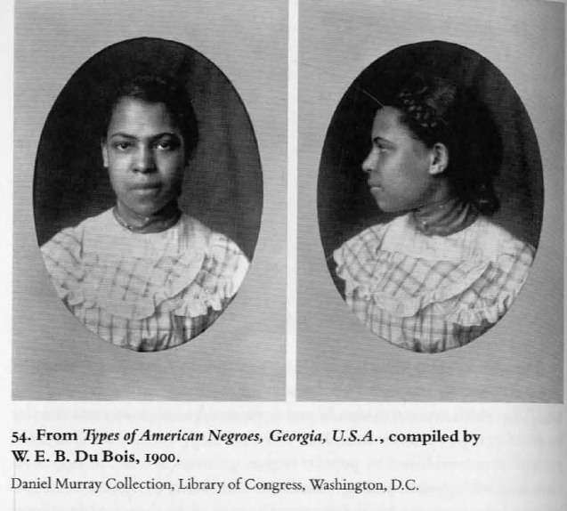
Signyfyin’
Du Bois's photographs repeat the visual tropes of the
criminal mug shot "with a difference," directing reading of the images by "indirection," and thereby inverting the dominant signification of these particular photographic signs.25 The initial portraits show expressionless
subjects photographed from the shoulders up, both head on and in rightangle profile, replicating uncannily the full face and profile headshots of the prison record. Further, the photographs depict subjects posed against
a plain gray background, devoid of props and frills, and reminiscent of the institutionalized walls against which legal offenders are posed.
In short, the
images in DuBois's albums repeat the formal signifiers of the criminal mug shots institutionalized in U.S. prisons and police archives in the late nineteenth century. In replicating the formal attributes of the criminal mug shot, Du Bois
was signifying on a pervasive cultural icon.
Notes:
Smith, Shawn Michelle. 2012 “’Looking at One’s Self through the Eyes of Others’ W.E.B. Du Bois’s Photographs for the Paris Exposition of 1900.” In Pictures and Progress, Early Photography and the Making of African American Identity, edited by Maurice O. Wallace and Shawn Michelle Smith, 274-298. Durham: Duke University Press.
See: http://www.loc.gov/pictures/collection/anedub/dubois.html

Slide 7
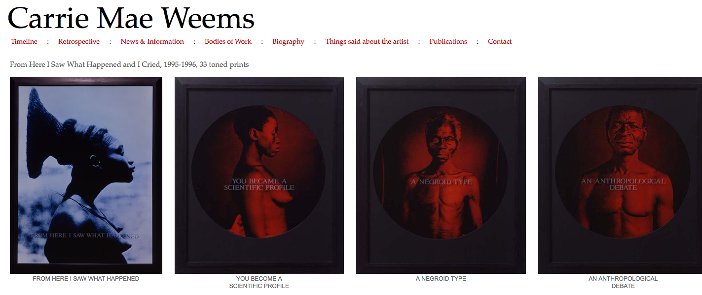
1981 - Receives BFA from the California Institute of the Arts. Ulysses Jenkins persuades her to consider graduate school, enrolls at University of California, San Diego.
http://carriemaeweems.net/galleries/from-here.html

Slide 8
https://www.khanacademy.org/humanities/global-culture/identity-body/identity-body-united-states/v/weems-from-here-i-saw-what-happened
Notes:
https://www.khanacademy.org/humanities/global-culture/identity-body/identity-body-united-states/v/weems-from-here-i-saw-what-happened

Slide 9
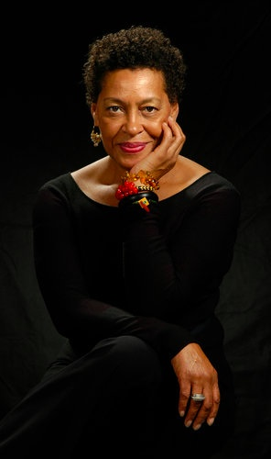
Weems began her career as an activist for the labor movement, followed by graduate work in fine art and, later, folklore. She selected the photographs in this series from the collection of the J. Paul Getty Museum, in Los Angeles. "When we’re looking at these images," Weems has said, "we’re looking at the ways in which Anglo America, white America, saw itself in relationship to the black subject. I wanted to intervene in that by giving a voice to a subject that historically has had no voice…. I used images that were preexisting, and my intervention was to reinscribe them by making them all consistent, in terms of size and scale and format and color." [Carrie Mae Weems, audio interview for MoMA 2000: Open Ends, The Museum of Modern Art and Acoustiguide, Inc., 2000.]
Carrie Mae Weems Credit Jerry Klineberg

Slide 10
Photographically, the "type" is expressed in a way which isolates, suppressing context and thus individuality. The specimen is in scientific isolation, physically, and metaphorically, the plain background accentuates physical characteristics and denies context. The meaning and "reality" of the subject can be given only by those who interpret the visual evidence.
The appropriation of the subject as a specimen was thus legitimised through science and achieved through the control of another science, photography. Through photography the specimens, "types", were neutralized and objectified for scientific use to be interpreted and reinterpreted.

Slide 11
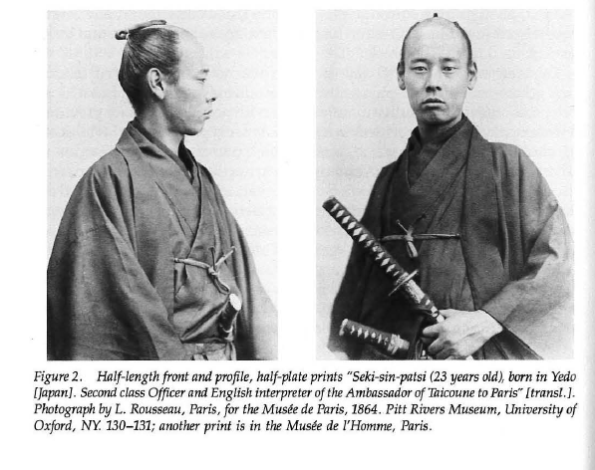

Slide 12
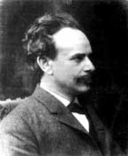
Boas was one of the most prominent opponents of the then popular ideologies of scientific racism, the idea that race is a biological concept and that human behavior is best understood through the typology of biological characteristics.^{[7]} In a series of groundbreaking studies of skeletal anatomy he showed that cranial shape and size was highly malleable depending on environmental factors such as health and nutrition, in contrast to the claims by racial anthropologists of the day that held head shape to be a stable racial trait.

Slide 13
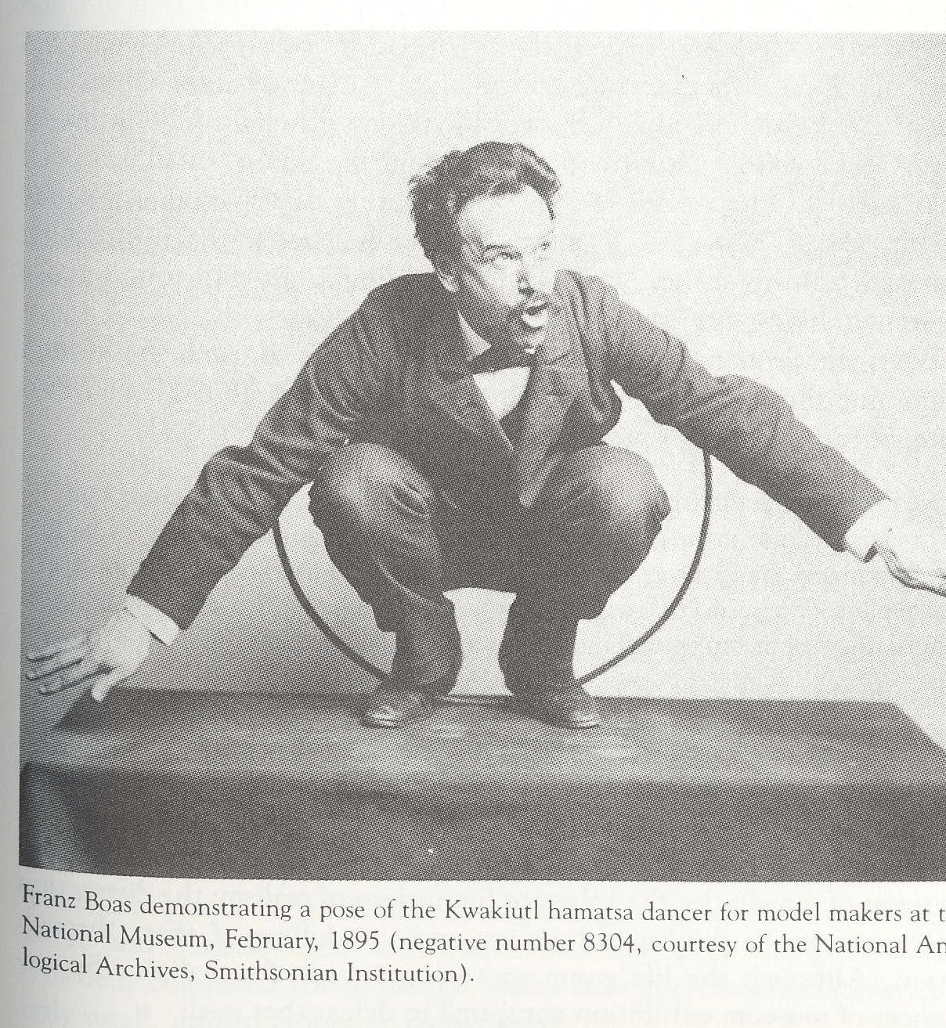
Franz Boas (1848-1942) father of American Anthropology Active during Anthropology’s “Museum Age” 1880-1920 Established the concept of cultures as diverse historical developments. Holistic and historic philosophies tied to training in geography and the German romantic tradition
Boas 1895, U.S. National Museum

Slide 14
Cultural Relativism
Contextual
The human mind has been creative everywhere - Boas
Evolution
Advance of mankind from primitive to complex – American Museum President Jesup
Among Boas's main contributions to anthropological thought was his rejection of the then popular evolutionary approaches to the study of culture, which saw all societies progressing through a set of hierarchic technological and cultural stages, with Western-European culture at the summit. Boas argued that culture developed historically through the interactions of groups of people and the diffusion of ideas, and that consequently there was no process towards continuously "higher" cultural forms.

Slide 15
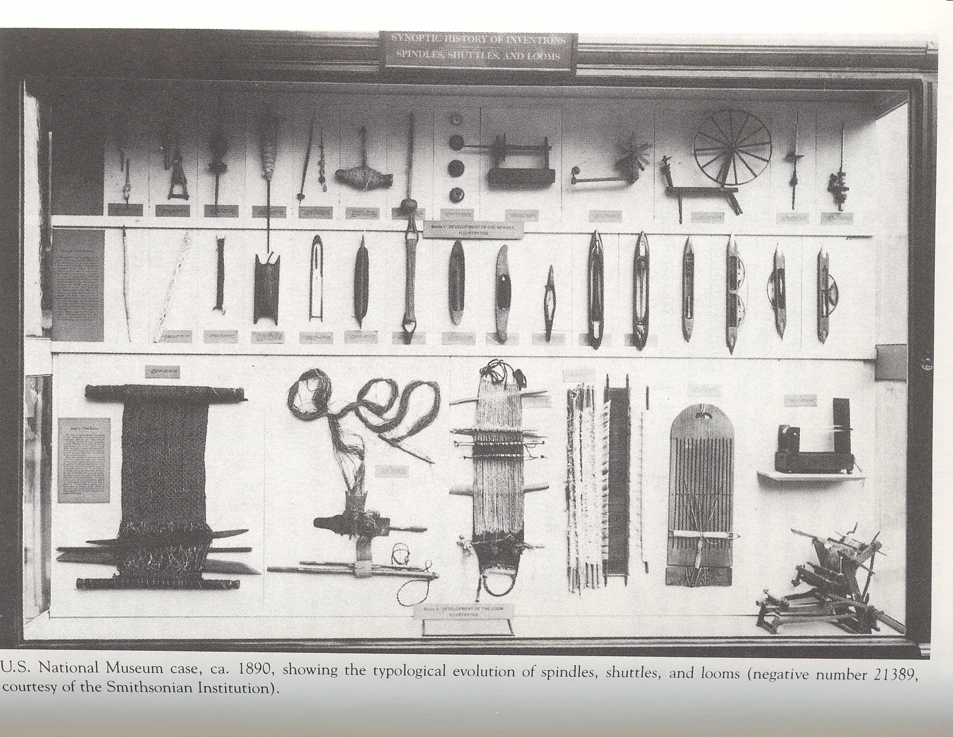
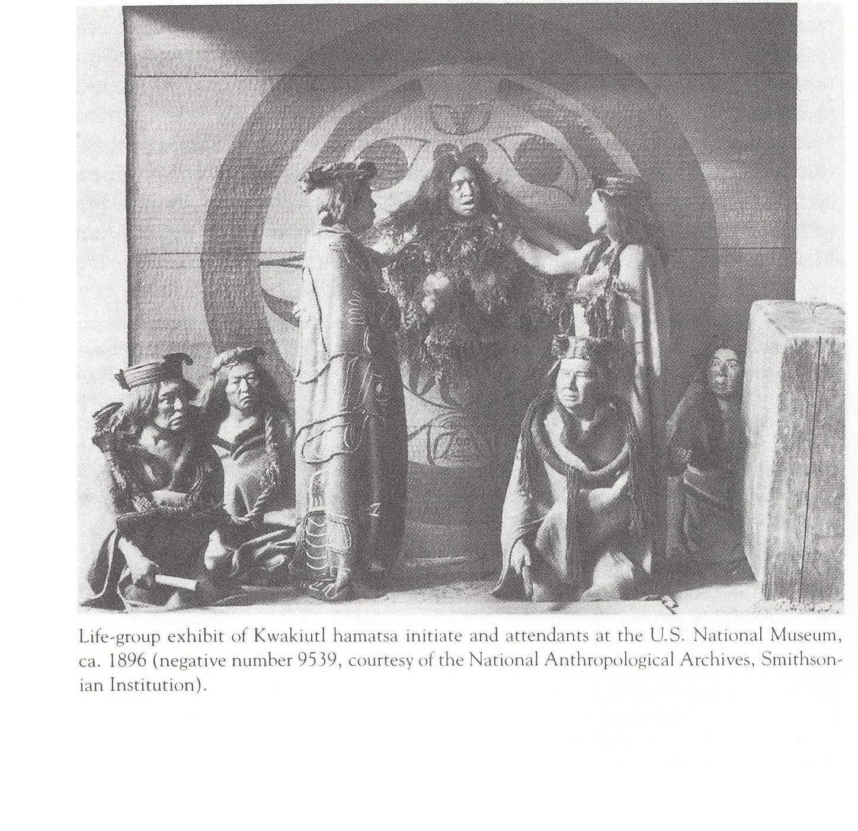
Typological vs. Life Group
U.S. National Museum, Typological, 1890
U.S. National Museum Life group, 1896

Slide 16
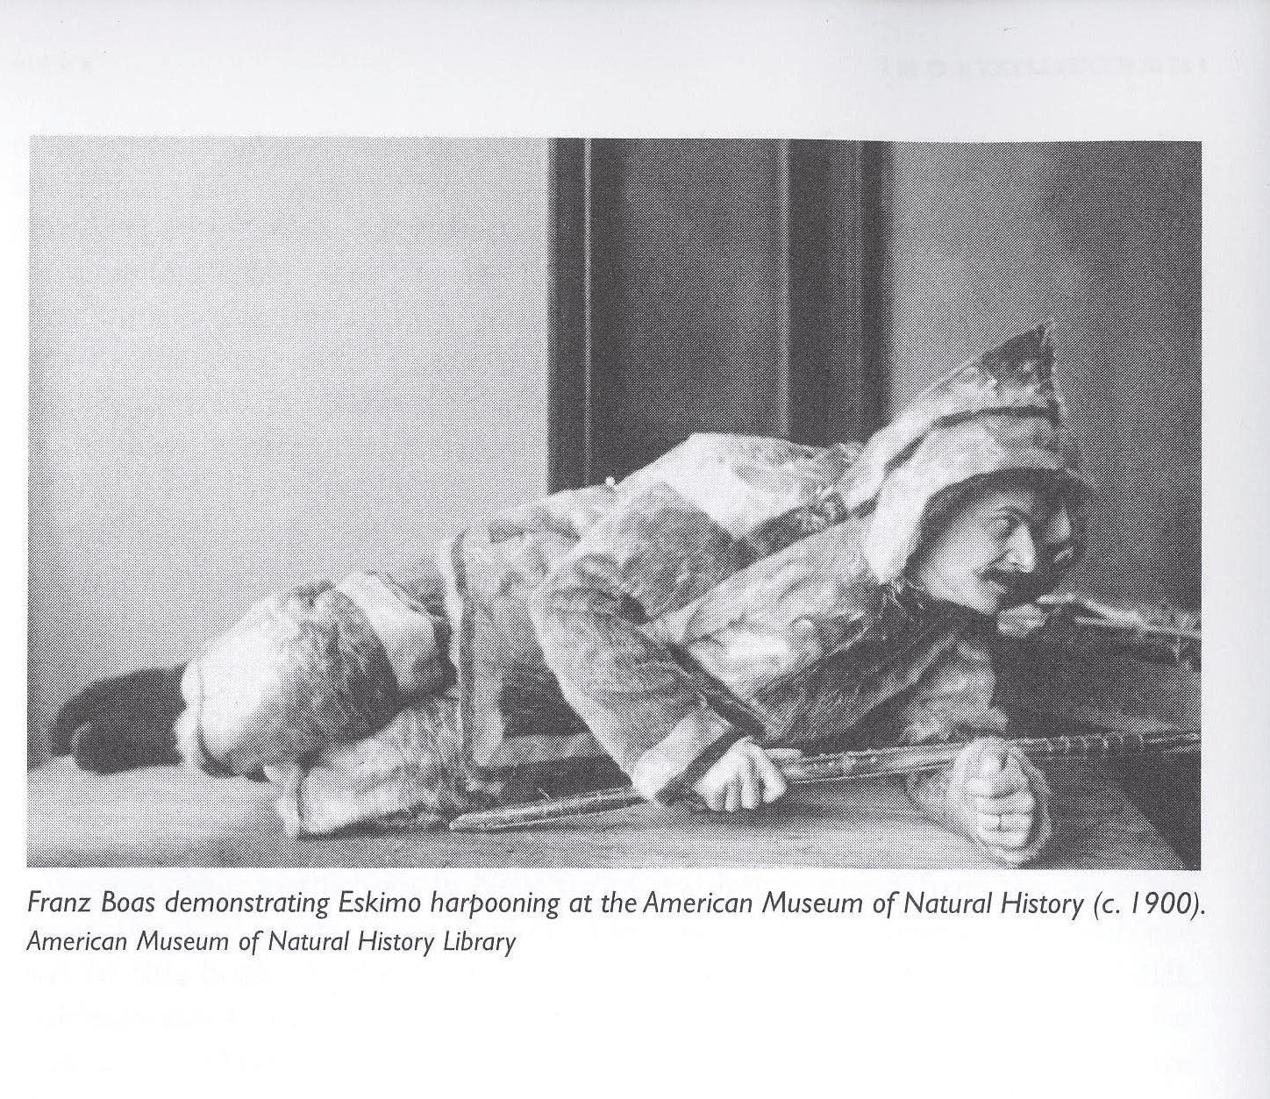
The Practice of Museum Exhibits
Boas at American Museum, 1900
No storage rooms, natural lighting, cases, life groups the most demanding (time, materials, skill), attempted realism. Labels – “the ultimate limitation to the possibility of a museum anthropology”. Boas believe the exhibited artifact secondary to the monographic interpretation of a scientist

Slide 17
Cultural Determinism
Anthropology
Behavior of all men determined by enculturation
Culture as primary determinant of behavior not race
Learned behavior paramount
Pre-anthropological culture singular, anthropological culture plural
Evolutionary theory (E.B.Tylor and Herbert Spencer)
Culture in its evolutionary sense, progressive accumulation of human creativity. Customs then viewed negatively as lower evolutionary status. See Stocking p. 870, 872.
Phenomenon of World’s Fairs as exemplary of evolutionary theses – ex. World’s Columbia Exposition (also called The Chicago World’s Fair) 1893, to celebrate the 400th anniversary of Columbus’s discovery of the “New World.”
Arguments for and against racial assumptions tied to material culture studies.

Slide 18
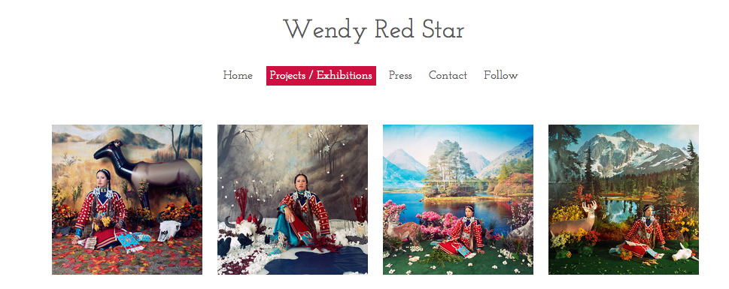

Slide 19
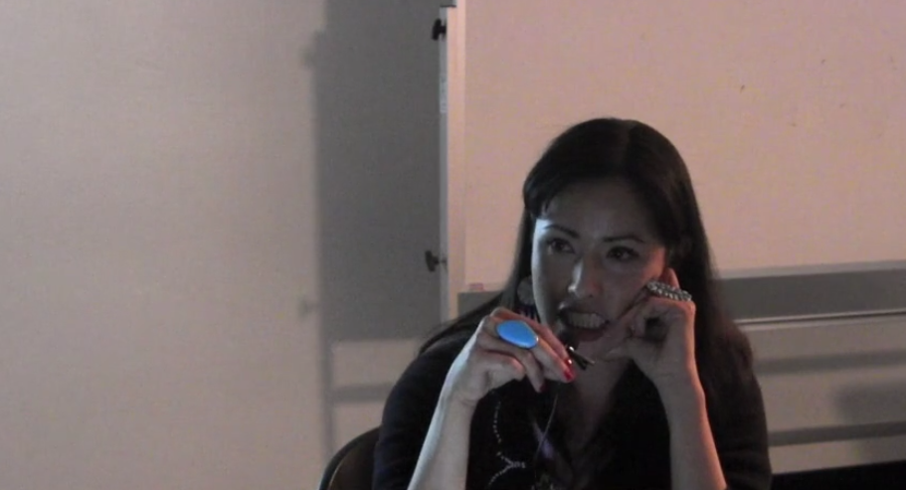
https://vimeo.com/124846515

