Slide 1
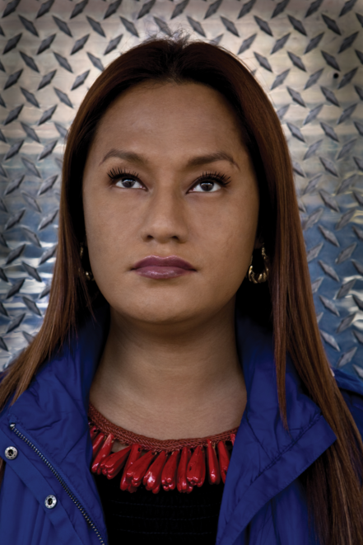
Born in Samoa in 1975 to a Japanese father and Samoan mother, Shigeyuki Kihara lived in Indonesia and Japan before she immigrated to New Zealand in 1989. She obtained an Advanced Diploma in Fashion Design and Technology at Massey University, Wellington, New Zealand. Kihara's works are in the collection of various New Zealand museums, including Museum of New Zealand Te Papa Tongarewa in Wellington, Waikato Museum of Arts and History in Hamilton, and the University of Auckland. In Australia, works are in the collection of the Sherman Contemporary Art Foundation and the Museum of Contemporary Art, Sydney; and in England at the University Museum of Archaeology and Anthropology in Cambridge. She currently lives and works in Auckland.

Slide 2
Her signature series entitled Fa'a fafine: In a Manner of a Woman (2004-5) is a powerful and forthright combination of social commentary and rigorous art practice addressing cultural and gender perceptions through performance and the medium of photography. "Fa'a fafine" is a Samoan word for a person who was born biologically male, who expresses feminine gender identities and lives as a female. For this series, the artist re-created studio tableaux by photographing herself as both a man and a woman in poses that mimic colonial images of Pacific Islanders; through the works, she examines Western perceptions and stereotypes as well as issues of gender identity.
http://www.metmuseum.org/exhibitions/listings/2008/shigeyuki-kihara
Initially struck by the way the studio photographs of Samoans eroticised their subjects by presenting them naked or semi-clothed as ‘noble savages’, perpetuating the myth of the Pacific as an exotic paradise through the mass production and dissemination of these images as postcards, Kihara has subsequently found them fertile ground for her art practice. Yet her reconstructions and reclamations of these images – often in the form of self-portraits naked and clothed – have a contemporary frisson. In them she exposes the colonial gaze and turns it back on itself so we become acutely aware of our own position as voyeurs – and of the way pictorial conventions of the past constructed and perpetuated racial, cultural and gender stereotypes, many of which still hold sway today.
http://www.artnews.co.nz/summer-2012-profile/

Slide 3
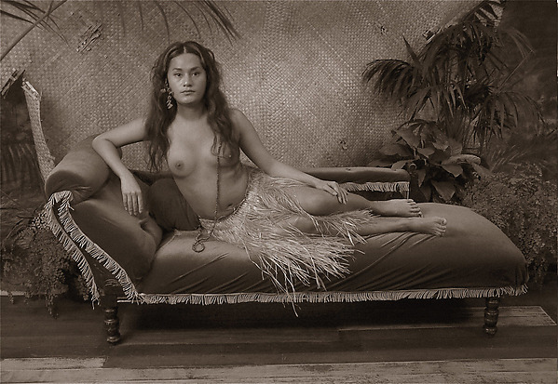
Fa'a fafine: In the Manner of a Woman, Triptych 1, 2004-2005, Digital formatting 60 X 80 cm

Slide 4
Fa'a fafine: In the Manner of a Woman, Triptych 2
2004-2005
Digital formatting 60 X 80 cm

Slide 5
The Samoan word fa'afafine is best described in Western terms as a third gender. The artist, herself a fa'afafine, re-creates studio tableaux in line with those staged by nineteenth-century photographers working in Samoa such as Thomas Andrew and Alfred John Tattersall, in which women and men were posed partially clothed among props and a backdrop of tropical foliage.
Fa'a fafine: In the Manner of a Woman, Triptych 3 2004-2005
Digital formatting 60 X 80 cm

Slide 6
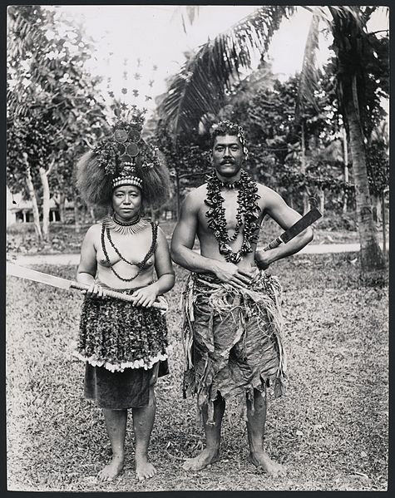
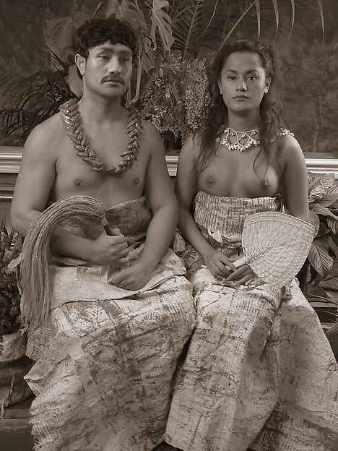
Alfred James Tattersall (1861 – 1951) was a New Zealand photographer[1] who lived in Samoa for most of his life and contributed a significant collection of images of the Pacific Island country and its peoples during the colonial era.
“Faumuina Mata’afa and wife, 1900’s”
Kihara
Ulugali'i Samoa: Samoan Couple
2004-5
80 X 60 cm

Slide 7
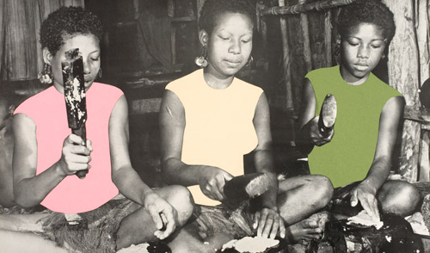
In the Black Sunday series (2001-2), she uses collage and digital photography to comment on how Samoans were pictured in19th-century colonial images. Among the works on view from the series is Gossip Sessions, showing three women preparing food; the artist remade the original photograph by adding on to the subject pastel-colored T-shirts made of paper collage and then re-photographing it.

Slide 8
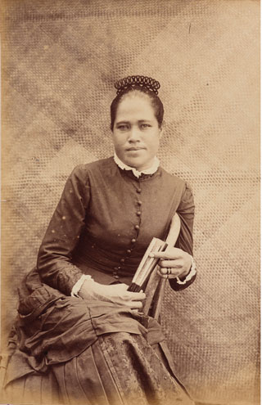
Among the photographs Kihara was researching at Te Papa one stood out – Samoan half caste, an image of a Samoan woman dressed in a Victorian mourning dress, taken by New Zealand photographer Thomas Andrew, who moved to Apia in 1891 to create studio portraits and images for the booming postcard industry. “I looked at this picture and saw that she looks very comfortable in this dress, and her gesture just oozes confidence and mana. And I wanted to understand the context of what was happening at the time the photograph was taken. The more I got into it, the more ideas it sparked off.”
Kihara tried to imagine what it would be like for this woman to perform the energetic movements of the taualuga in such restrictive clothing – a style of dress first introduced to Samoa by the German colonial administration in the 1900s. And so the idea, which is a potent metaphor for loss, the impact of colonialism on Samoa, and the bizarre fusions of different cultural traditions that resulted from it, was born. Over the next decade it would manifest itself in a series of performances and videos.
http://www.artnews.co.nz/summer-2012-profile/

Slide 9
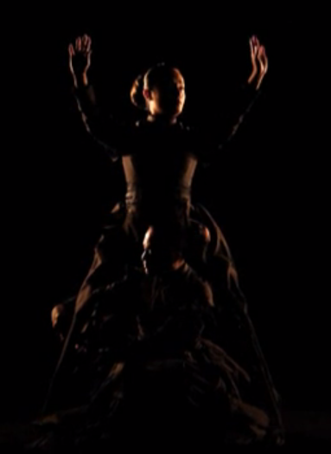
In Samoa there’s a long tradition of storytelling and archiving social and political history through song and dance. When Samoan-Japanese artist Shigeyuki Kihara made her silent performance video, Galu Afi; Waves of Fire, 2012, she was following this tradition, performing her own haunting version of a classical Samoan dance, the taualuga, to lament the 189 victims of the 2009 tsunami which struck Samoa, American Samoa and Tonga.
https://vimeo.com/50271507

Slide 10
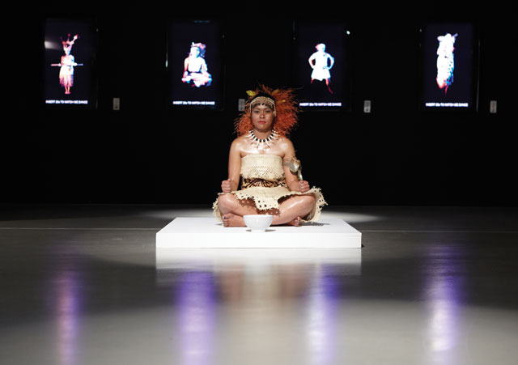
Culture for Sale references the völkerschau or ‘human zoo’ – a popular form of exotic entertainment in Germany during the colonial era. Last year Kihara travelled to Germany where she researched museum archives, following the historical footprints of several groups of Samoans – men, women and children – who toured big cities in Germany where they were exhibited behind a fence in a völkerschau.
https://vimeo.com/40031800
Shigeyuki Kihara, Culture for sale, 2012. Live performance and exhibition commissioned by Campbelltown Arts Centre and 4a Centre for Contemporary Asian Art, Sydney, for Sydney Festival 2012. Courtesy of Shigeyuki Kihara, Campbelltown Arts Centre and 4a Centre for Contemporary Asian Art, Sydney. Photo: Susannah Wimberley
Notes:
http://blog.qagoma.qld.gov.au/highlight-shigeyuki-kihara/

