Slide 1
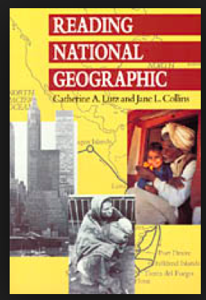
Catherine Lutz and Jane Collins take us inside the National Geographic Society to investigate how its photographers, editors, and designers select images and text to produce representations of Third World cultures. Through interviews with the editors, they describe the process as one of negotiating standards of "balance" and "objectivity," informational content and visual beauty. Then, in a close reading of some six hundred photographs, they examine issues of race, gender, privilege, progress, and modernity through an analysis of the way such things as color, pose, framing, and vantage point are used in representations of non-Western peoples. Finally, through extensive interviews with readers, the authors assess how the cultural narratives of the magazine are received and interpreted, and identify a tension between the desire to know about other peoples and their ways and the wish to validate middle-class American values. 1993

Slide 2
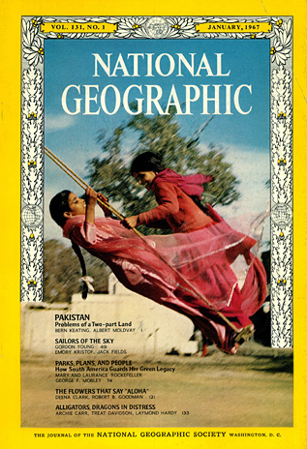
Collins and Lutz “Our book is not at all about the non-Western world but about its appropriation by the West and National Geographic’s role in that appropriation.”
NG “invites (readers) to look out at the rest of the world from the vantage point of the world’s most powerful nation.”(p.7)
The NG Genre 1950-1986
Exotic – spectacle
ritual (past, flattens emotional life)
dress (draw attention away from conflict)
color (the language of consumption and plenty)
Idealized - Beautification of the world’s people
Smile (eye contact)
Portrait (humanizes, individualizes, imperialist nostalgia)
Group (rarely named)
Gentle natives (ever innocent/apolitical)
Middle class/work
Virility
Naturalized
Two worlds
Sexualized
Naked women

Slide 3
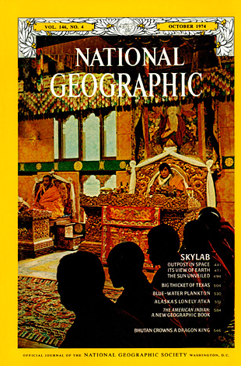
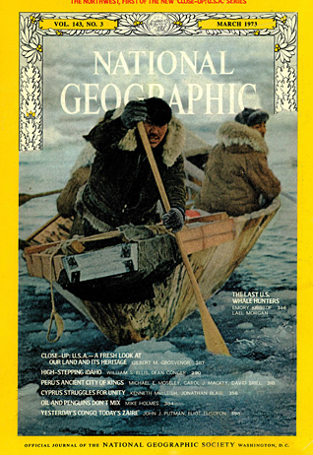
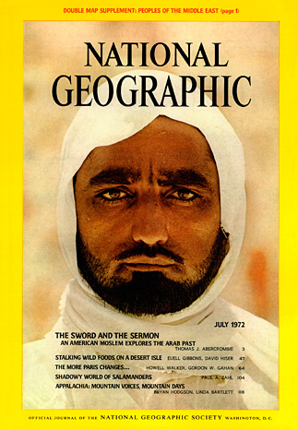
The Primitive Contrast
Identity formation draws upon the image of the other – contrast, inversion
Clifford (1988, The Predicament of Culture)– content of category non-Western or “primitive” change over time – used to construct alterego or confirm western self

Slide 4
The Gaze in Intercultural Relationships
The photographer’s gaze (through the viewfinder)
The institutional gaze (cropping, magazine, captions, etc)
The reader’s gaze
The non-Western subject’s gaze
The explicit looking done by Westerners while with natives in a picture
The returned gaze in native’s hands
Our own academic gaze
Variables:
Photosubject matter
Composition
Vantage point
Color balance
Framing
Sharpness
Depth of focus
PLUS:
Class, race, gender

Slide 5
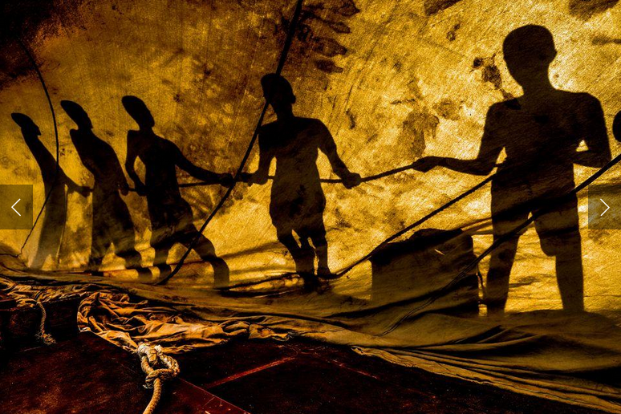
“The reader’s gaze has a history and a future”
Structured by the mental world of inference and imagination
Does a photograph provoke empathy or distance?
A central paradox in photographs of non-Western others – participation or alienation?
http://photography.nationalgeographic.com/contest-2015/

Slide 6
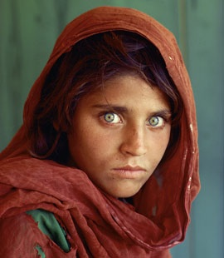
Afghan Girl Revealed
http://ngm.nationalgeographic.com/2002/04/afghan-girl/sight-and-sounds-interactive

Slide 7
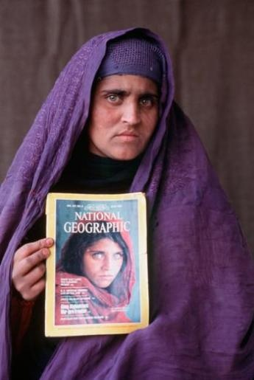

Slide 8
The Returned Look
Does a frontal portrait with eye contact indicate agency (confrontational)
or a lack of agency (voyeurism –surveillance)
In National Geographic:
Women look into the camera more than men
Children and elders look into the camera more than other adults
Those who appear poor look into the camera more than those who appear wealthy
Traditional dressed subjects look into the camera more than those dressed in western garb
Those whose skin is dark look into the camera more than those who skin is lighter
“Frontality’s work as a code of social inferiority”
The “civilized” classes since the 19th century have typically been depicted as turning away from the camera. NO change as cameras became more common over time. “Full civilization still belongs, ideologically to the Euro-American”

Slide 9
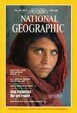
Do Images Matter? “more or less harmful ways of viewing difference”
Strategies for describing human differences have helped create and reproduce social hierarchies (p. 3)
“At the least these hierarchies have created small humiliations and rejections, and have lessened opportunities. At the worst, they have abetted wars of extermination, lynchings, and rape. Representations…are never irrelevant, never unconnected to the world of actual social relations.”
http://www.nationalgeographic.com/ngm/100best/multi1_interview.html

Slide 10
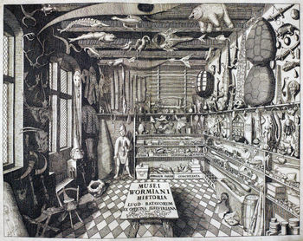
Science and Entertainment Blurred
National Geographic both produces knowledge and represents it
Tie with museums (natural history, cabinet of curiosities, natural history diorama)– meaning is created selectively while destroying original context (p. 23)
www.seeing-stars.com
http://en.wikipedia.org/wiki/Cabinet_of_curiosities

Slide 11
Objective Photography
The naturalist argument in photography (p. 66) “The value of the picture resides in its truth observation. This value is jeopardized to the extent that the photographer intervenes in the social circumstances, causing a rupture in what naturally would have happened” (Becker, Art Worlds 1978)
www3.nationalgeographic.com/.../ft_hdr.5.jpg

Slide 12
Universalism
Photography at NG midway between art photography and photojournalism
NG’s “Classic Humanism” vs. “Progressive humanism” (Roland Barthes, Mythologies 1972)
Classic humanism – beneath thin veneers of difference, one quickly reaches “the solid rock of human nature,”
Progressive humanism (p. 61) - constantly examine what is purported to be to be natural and universal “in order to discover History there..”
Family of Man, Edward Steichen, 1955

Slide 13
Edward Steichen,The Family of Man, 1955
The Family of Man (MoMA Exh. #569, January 24-May 8, 1955) was composed of 503 photographs grouped thematically around subjects pertinent to all cultures, such as love, children, and death. After its initial showing at The Museum of Modern Art in 1955, the exhibition toured the world for eight years, making stops in thirty-seven countries on six continents. In this photograph, the curator Edward Steichen, former Director of the Museum's Department of Photography, leads a group of visitors through The Family of Man at the Hochschule für Bildende Künste (Academy for Creative Arts) in Berlin in 1955. The photographs included in the exhibition focused on the commonalties that bind people and cultures around the world and the exhibition served as an expression of humanism in the decade following World War II. ,” one of the most celebrated photography exhibits of the 20th century
http://www.moma.org/research/archives/highlights/06_1955.html

Slide 14
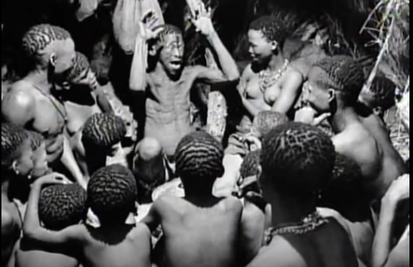
https://www.youtube.com/watch?v=X343f0Go0Wo

