Slide 1
What is an archive and why is it so important for photographers?
Take 7-10 minutes and write your thoughts about your own experience with an archive. You do not need to place your name on your response.
Your own archive – family photos, your papers
A relative’s archive – your mother’s or father’s or grandparent’s papers or photos
An “official” archive –school, community, museum
After you finish writing we will exchange responses and discuss.

Slide 2
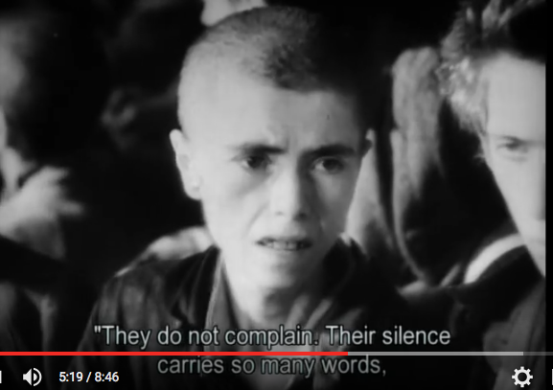
The Archive
“Let The World Read and Know”
Oneg Shabbat Archives
“No day was like the next and the scenes changed as fast as a movie. That’s why it was important to photograph every event in Jewish life as it happened, while it fluttered and bubbled.
https://www.youtube.com/watch?v=BnrpJkwj450

Slide 3
Henryk Ross, Photographer
Most of the images that have become the visual memory of the Holocaust were photographed by or for the perpetrators. Many of them were posed or staged for particular purposes: to make the Germans look powerful, to humiliate victims, to celebrate triumph and destruction. When we use such photographs unquestioningly, we run the risk of reproducing the perpetrators’ gaze, of seeing events through their eyes. Henryk Ross’s photographs have their own complex perspective, but it is not the line of vision of the masters and killers. Instead of the overexposed, stock view of “the Jew,” they offer an underexposed, bewildering glimpse of Jewish lives in the ghetto, as seen from the inside.
Ross openly and secretly photographed roundups and transports of Jews, perhaps with the photojournalist’s impulse to capture momentous events, perhaps with the hope of using the images one day as evidence. He also photographed people in the ghetto in happy moments: playing, celebrating, kissing. Some of those images may have been commissioned by acquaintances, friends or members of the ghetto elite, for instance, Jewish policemen who wanted pictures of their children.
After the war, Ross used some of his photographs to accuse perpetrators of the Holocaust, at the 1961 trial of Adolf Eichmann in Israel, and in various publications.
http://agolodzghetto.com/dorisbergen?t:state:flow=a14543fa-4023-4e64-adda-ca2204aba9ab

Slide 4
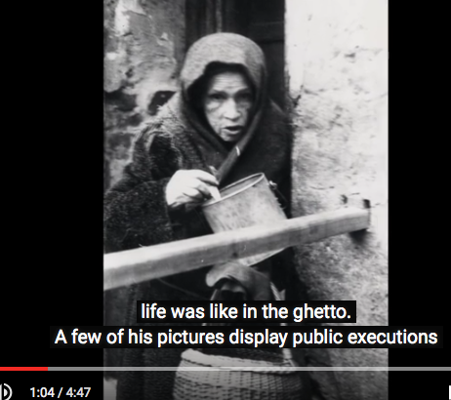
Documentation of Atrocities: The Jewish Photographer Henryk Ross
https://www.youtube.com/watch?v=dr3PeT-Fxyc

Slide 5
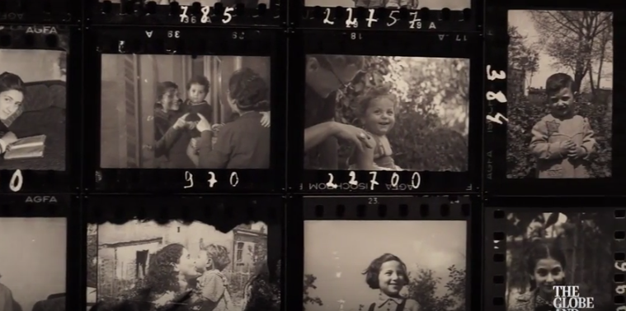
Memory Unearthed: The Lodz Ghetto Photographs of Henryk Ross
At Gallery of Ontario
“The Whole Arc of Life”
https://www.youtube.com/watch?v=pBDbtsxSiRA&nohtml5=False

Slide 6
This winter the AGO offers an extraordinarily rare glimpse of life inside the Lodz Ghetto during the Second World War through the daring lens of Polish Jewish photojournalist Henryk Ross (1910-1991). Situated in the heart of Poland, the city of Lodz was occupied by German forces in 1939 and became the country’s second largest ghetto for the Jewish population of Europe, after Warsaw. Incarcerated in 1940 and put to work as a bureaucratic photographer by the Jewish Administration’s Statistics department, Ross unofficially—and at great personal risk—took thousands of images of daily life in the ghetto. These profoundly urgent representations of Jewish life in the ghetto, taken through cracks in doors or through Ross’s overcoat, capture the complex realities of life under Nazi rule, from the relative privileges enjoyed by the elites to the deportation of thousands to death camps at Chelmno and Auschwitz. “Having an official camera,” Ross later recalled, “I was able to capture all the tragic period in the Lodz Ghetto. I did it knowing that if I were caught my family and I would be tortured and killed.”
http://agolodzghetto.com/objects/viewcollections?t:state:flow=20cfdae6-33a0-445b-a02d-ffe59b85fe44

Slide 7
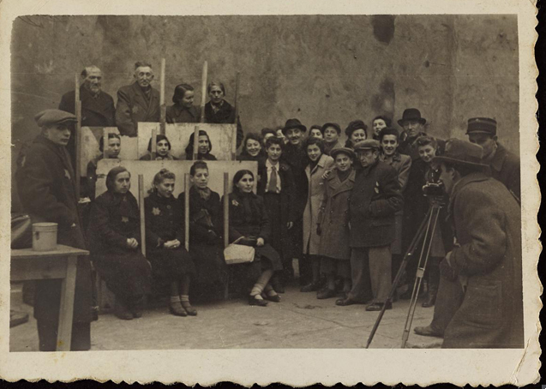

Slide 8
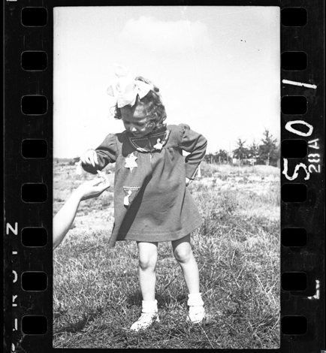
Notes:
1940- 1941

Slide 9
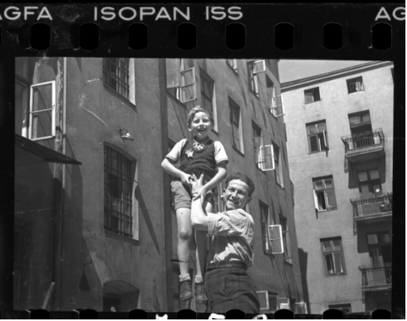
Man holding child in the air, outside of ghetto buildings
Date: 1940-1944

Slide 10
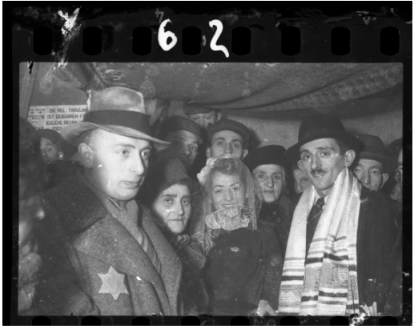
The marriage of Henryk Ross and Stefania Schoenberg: standing group
Date: 1941

Slide 11
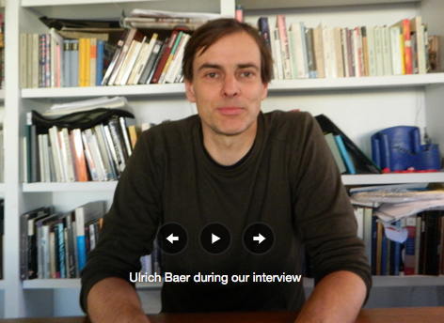
Ulrich Baer
The photographic archive as melancholic but also offers the possibility of “opening up new worlds, of offering new historical identities.”
ULRICH BAER is Professor of German and Comparative Literature at New York University. He is the author of Spectral Evidence: The Photography of Trauma, 110 Stories: New York Writes after 9/11, and Remnants of Song: Trauma and the Experience of Modernity in Charles Baudelaire and Paul Celan

Slide 12
- The original intention of recording for the future becomes clouded by melancholia
The archive seems to tinge its subject with death: what is found in the archive bears testimony to everything that could not be collected but was lost
Archives bestow legitimacy and preserve certain forms of knowledge
Archives transmit culturally and historically specific modes of remembrance.
But even in dogmatically conceived and tightly controlled archives there is an opening.
Photographs like archives have the capacity of contingent, accidental or strategic interpretations.
ONLY interpreting the archive as as evidence of trauma (melancholy) is limiting. Alternatives for new life in the archive and the photo.

Slide 13
Three Modes of Engagement in the Archive
The fabricated or constructed archive
The archive of the unremembered
The archive’s redemption for new life
To conduct research in an archive means to acknowledge that something contained therein might also undo the question that brought us here in the first place.

